Slide 1
SLEDS: A DSL for Data-Centric Storage
on Wireless Sensor Networks
Marcos A. Carrero, Aldri L. dos Santos, Carmem S. Hara
Federal University of Paraná (UFPR), Curitiba-PR, Brazil
Martin A. Musicante
Federal University of Rio Grande do Norte (UFRN), Natal-RN, Brazil
BIDU 2018
Rio de Janeiro, August 31st
Notes:
1
1
1
Good morning everyone. Thanks for coming to my presentation.
I´m Marcos from UFPR/Brazil and the topic of my presentation is A Reusable Component-Based Model for WSN Storage Simulation
This paper is co-authored by Martin Musicante, Aldri Santos and Carmem Hara

Slide 2
Outline
Introduction
Components and State Machine Models
SLEDS Language
Evaluation
Conclusion and Future Works
2
Notes:
2
2
2
I have divided my talk into five parts:
The first part concerns to the motivation, main problems and the proposed solution
Second, I´m going to describe the data storage component model.
In the third part I will describe our proposal – the RCBM Architecture
Then I´ll move to report the performance evaluation
Finally, I´ll conclude with highlighting future works

Slide 3
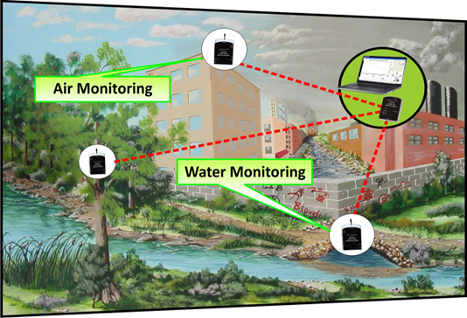
Introduction
Motivation
Urban Sensor Networks
High density, large-scale WSNs
Huge volume of a wide variety of sensed data
Demand for scalable storage models
3
Notes:
3
3
3
Now let’s turn to the data storage development applications for simulation tools.
The main problems are that systems are integrated in… and the lack
Software components models are a good approach to tackle these problems
reduce development complexity
improve productiviry
It also promotes software
Allowing developers to build systems from reusa..

Slide 4
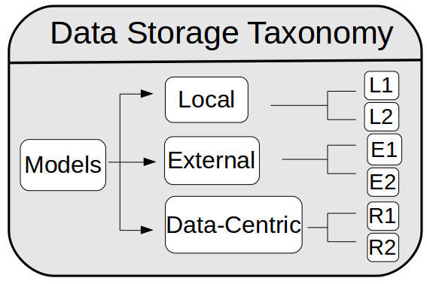
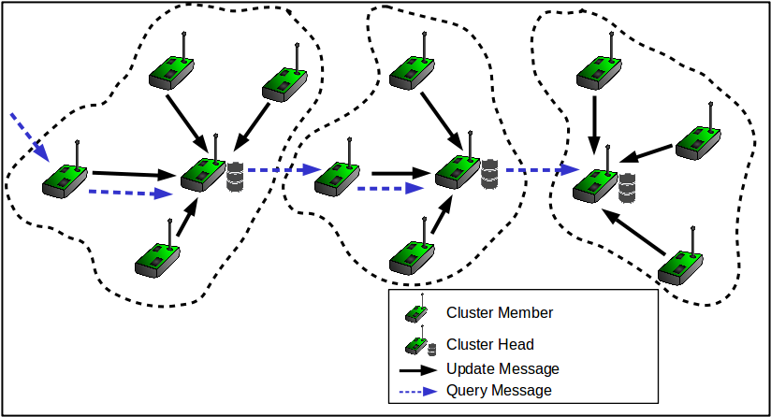
Introduction
Data Storage Models
4
Notes:
4
4
4
Now let´s consider the data storage models with more details.
In the graph (a) we describe the taxonomy of data storage models.
The focus of our work is in the Repositories class
For models in the repository class we identify common entities and tasks
For example, the sensor devices are responsible for storing neighboring information
The cluster heads define functions for leader election, storing readings of a group of sensors and answering queries
The cluster members define functions related to cluster membership and to report readings to the CHs

Slide 5
Introduction
Problem
Simulation tools
Validation of storage models before deployment
Little to no support for code reusability
How to improve the efficiency of system development and evaluation?
Main goal
Support for prototyping WSNs applications
Generate code for simulation environment
5
Notes:
5
5
5
Now let’s turn to the data storage development applications for simulation tools.
The main problems are that systems are integrated in… and the lack
Software components models are a good approach to tackle these problems
reduce development complexity
improve productiviry
It also promotes software
Allowing developers to build systems from reusa..

Slide 6
Introduction
Our Idea
Software components models
Reduce development complexity
Improve productivity and code reuse
Agile development
State machine
Formalize the interaction between components
SLEDS
DSL that closely resembles a state machine
Allow the programmer to define the flow of activities in a higher-level of abstraction
6
Notes:
6
6
6
Now let’s turn to the data storage development applications for simulation tools.
The main problems are that systems are integrated in… and the lack
Software components models are a good approach to tackle these problems
reduce development complexity
improve productiviry
It also promotes software
Allowing developers to build systems from reusa..

Slide 7
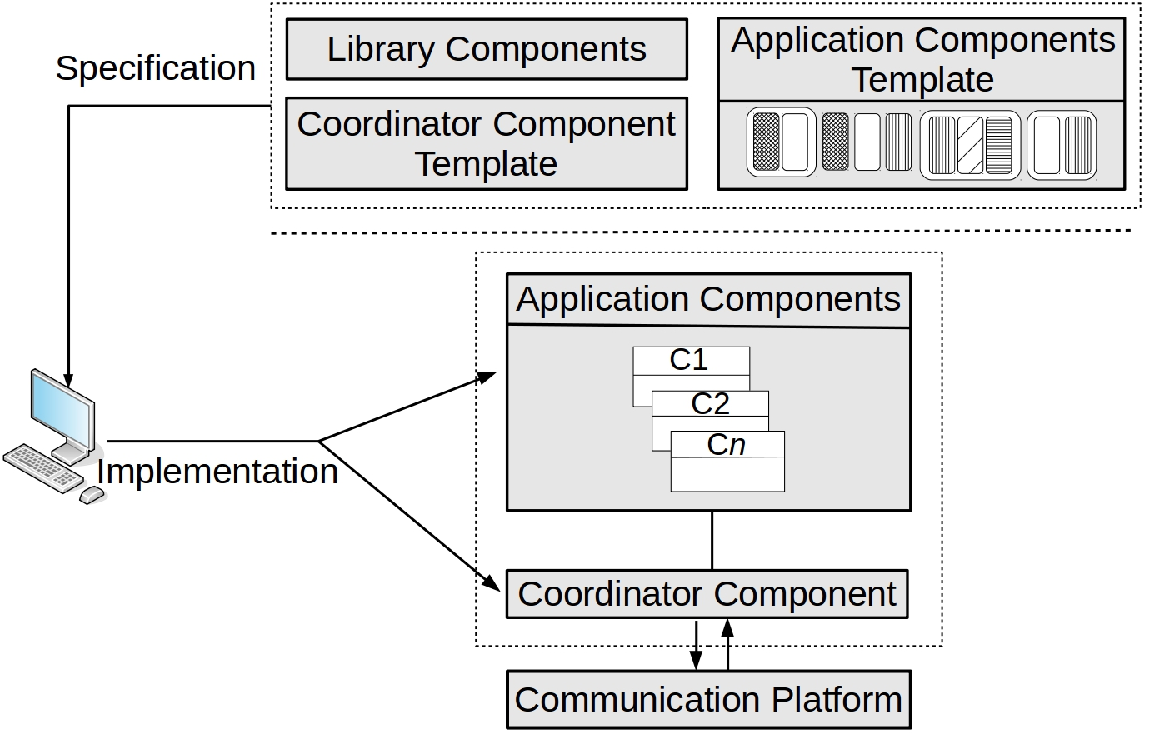
RCBM
Architecture
Library Components
Useful functions common to several models. Ex: Aggregation and timer
Application components
Refer to entities that are directly related to WSN storage models
Coordination Component
Coordination execution flow and interaction between components
Communication Platform: NS2 simulation environment
7
Notes:
7
7
7
Let´s take a closer look of the model architecture
At specification layer, the Library Components are not related to entities but provides useful functions common to several models, for example, aggregation and timer functions
The application components are directly related to WSN storage models
And the coordination

Slide 8
State Machine
recv SENSOR_ID
INI
[If myID==0
send SENSOR_ID]
Wait_First_Sensor_ID
[send SENSOR_ID]
Form_Neighbor_List
[initTimer(tFlood)]
recv SENSOR_ID
timer tFlood
recv ACK_SENSOR_ID
EXIT
Store_Neighbor_List
[initTimer(tExit)]
ACK_Neighbor_List
[send ACK_SENSOR_ID]
timer tExit
Each state has a name
Notation between brackets
send message, timer initialization
8
Notes:
8
8
8
8
8

Slide 9
State Machine
recv SENSOR_ID
INI
[If myID==0
send SENSOR_ID]
Wait_First_Sensor_ID
[send SENSOR_ID]
Form_Neighbor_List
[initTimer(tFlood)]
recv SENSOR_ID
timer tFlood
recv ACK_SENSOR_ID
EXIT
Store_Neighbor_List
[initTimer(tExit)]
ACK_Neighbor_List
[send ACK_SENSOR_ID]
timer tExit
State transition
Logic State Change
Event State Change
9
Notes:
9
9
9
9
9

Slide 10
SLEDS Syntax
recv SENSOR_ID
INI
[If myID==0
send SENSOR_ID]
Wait_First_Sensor_ID
[send SENSOR_ID]
Form_Neighbor_List
[initTimer(tFlood)]
recv SENSOR_ID
use compSensor as ComponentsSensor;
use compLibMSG as ComponentsLibMessage;
Program Coordinator () {
int myID = compSensor→getSensorId();
int msgID;
STATE INI() {
if (myID == 0) {
msgID = compLibMSG → GetNextMsgId ();
broadcast ( SENSOR_ID, msgID, myID );
compLibMSG → addSeenMsg (SENSOR_ID, msgID );}
nextState Wait_First_Sensor_ID ();}
Components
Variables
Send message
Logic state change
10
Notes:
10
10
10
10
10

Slide 11
SLEDS Syntax
recv SENSOR_ID
Wait_First_Sensor_ID
[send SENSOR_ID]
INI
[If myID==0
send SENSOR_ID]
recv SENSOR_ID
Form_Neighbor_List
[initTimer(tFlood)]
use compSensor as ComponentsSensor;
use compLibMSG as ComponentsLibMessage;
Program Coordinator () {
...
STATE Wait_First_Sensor_ID() {
on recvBroadcast (SENSOR_ID, msgID, ID) {
listSensorAnnouncements.insert ( ID );
if (!compLibMSG → seenMsg (SENSOR_ID, msgID )) {
compLibMSG → addSeenMsg (SENSOR_ID, msgID );
broadcast (SENSOR_ID,msgID, myID ); }
nextState Form_Neighbor_List (); } }
Components
Received msg
Send message
Event state change
11
Notes:
11
11
11
11
11

Slide 12
Translation to NS2
recv SENSOR_ID
INI
[If myID==0
send SENSOR_ID]
Wait_First_Sensor_ID
[send SENSOR_ID]
Form_Neighbor_List
[initTimer(tFlood)]
recv SENSOR_ID
NS2
SLEDS
12
Notes:
12
12
12
12
12

Slide 13
Translation to NS2
recv SENSOR_ID
Wait_First_Sensor_ID
[send SENSOR_ID]
INI
[If myID==0
send SENSOR_ID]
recv SENSOR_ID
Form_Neighbor_List
[initTimer(tFlood)]
13
Notes:
13
13
13
13
13

Slide 14
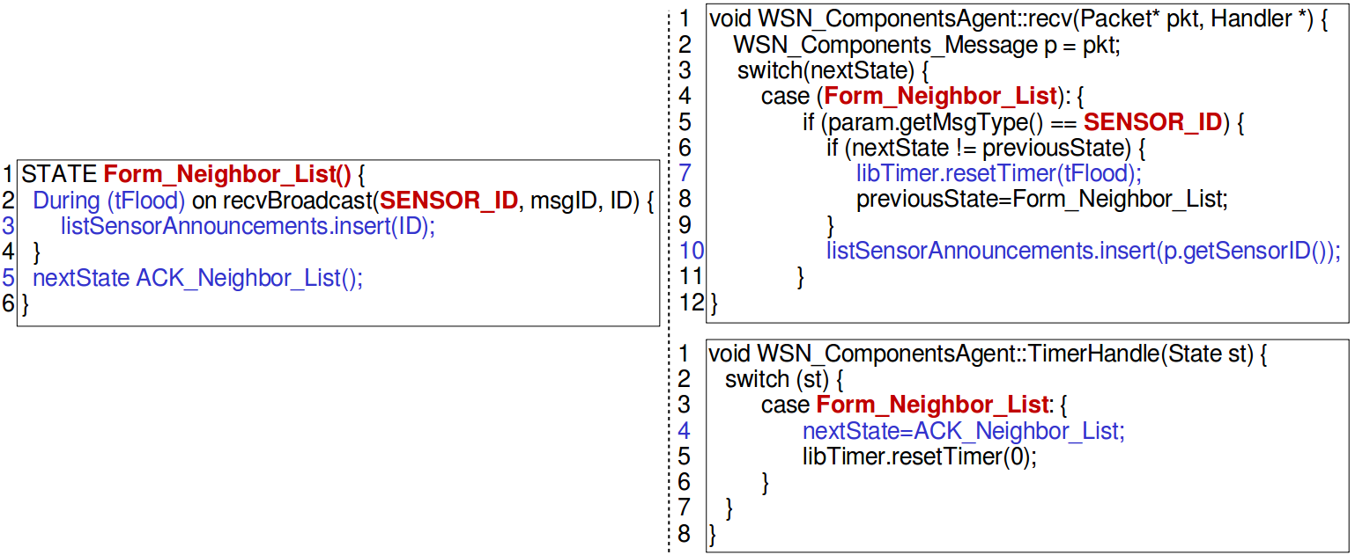
Translation to NS2
recv SENSOR_ID
Form_Neighbor_List
[initTimer(tFlood)]
INI
[If myID==0
send SENSOR_ID]
Wait_First_Sensor_ID
[send SENSOR_ID]
recv SENSOR_ID
14
Notes:
14
14
14
14
14

Slide 15
SLEDS Grammar
Program := Program Id(Type Id(, Type Id) ∗ ) {
StateDef∗ }
StateDef := State Id(Type Id (,Type Id)∗) { ActionList }
State := Id ( ExpList? ) | exit
ActionList := Action ( Action )∗
Action := nextState State;
| broadcast (Exp, Exp, ExpList);
| send (Exp, Exp, ExpList, ExpList);
| on recvBroadcast (Id, Id, IdList) { ActionList }
| on recv (Id, Id, IdList, IdList) { ActionList }
| during (Exp) on recvBroadcast (Id, Id, IdList)
{ ActionList } nextState State;
| during (Exp) on recv (Id, Id, IdList, IdList)
{ ActionList } nextState State;
| while (Exp) { ActionList } | if (Exp) { ActionList }
| for Id in Exp { ActionList }
15
Notes:
15
15
15
15
15

Slide 16
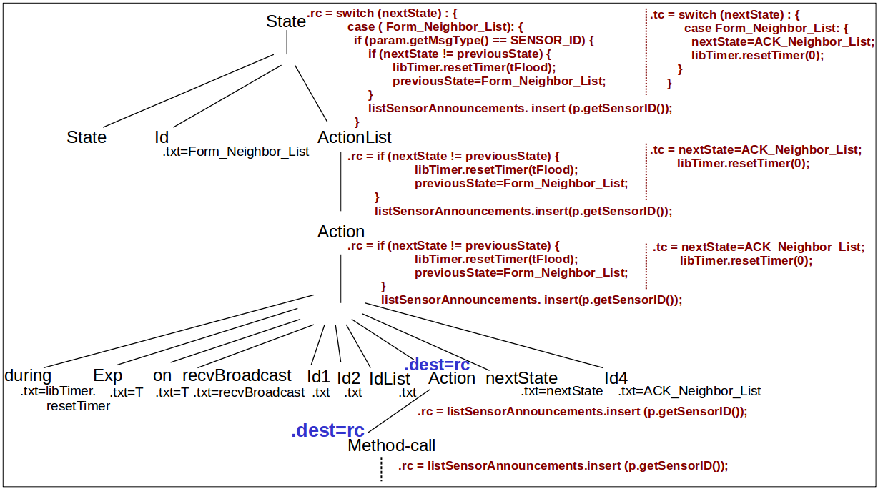
Syntax-directed translation
.rc → recv
.tc → TimerHandle
Parse tree for the Form_Neighbor_List state
16
Notes:
16
16
16
16
16

Slide 17
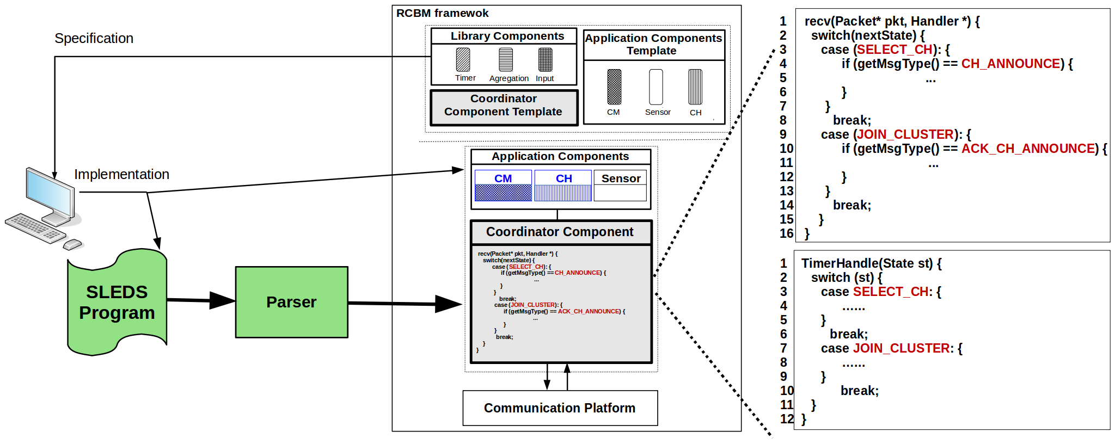
SLEDS back-end architecture
17
Notes:
17
17
17
17
17

Slide 18
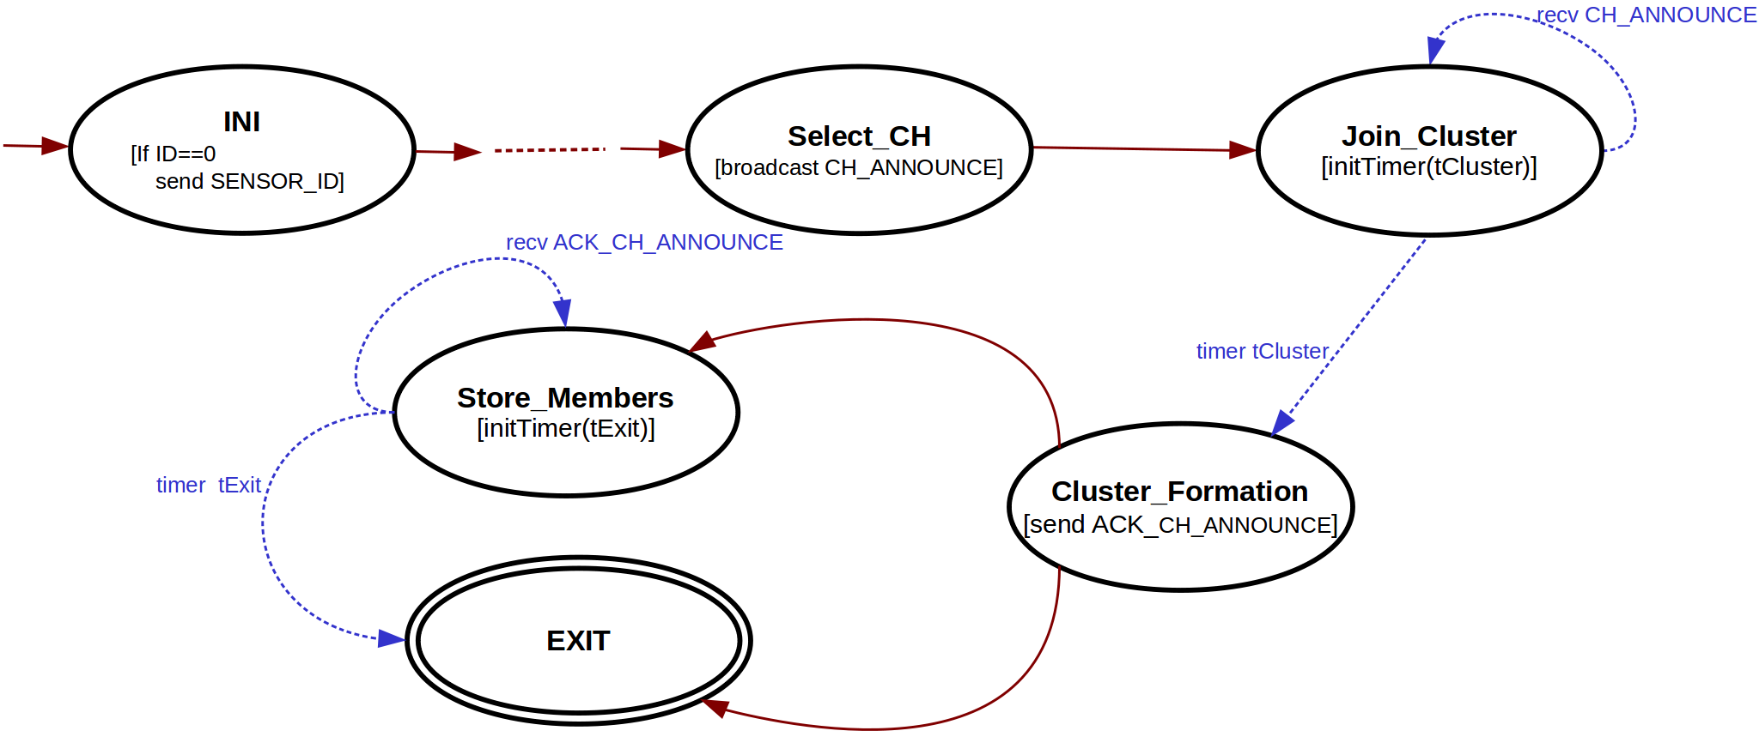
Validation
LCA: sensor ID
LEACH: probabilistic
LCA: lowest id
LEACH: Max. signal strength
State machine for LEACH and LCA storage models
18
Notes:
18
18
18
18
18

Slide 19
Validation
STATE Join_Cluster () {
During (tCluster) on recvBroadcast (...) {
RSS = compSensor → getRSS (ID);
knownCHs.insert (ID, RSS); }
nextState Cluster_Formation (); }
STATE Join_Cluster () {
During (tCluster) on recvBroadcast (...) {
RSS = compSensor → getRSS (ID);
knownCHs.insert (ID, RSS); }
nextState Cluster_Formation (); }
LEACH
LCA
19
Notes:
19
19
19
19
19

Slide 20
Validation
STATE Select_CH () {
if (compCH → selectCH (myID, p )) {
broadcast (...);
compSensor → role=CH ; }
else {
compSensor → role=CM ; }
nextState Join_Cluster (); }
STATE Select_CH () {
if (compCH→selectCH (myID, knwonNeighbors )) {
broadcast (...);
compSensor → role=CH ; }
else {
compSensor → role=CM ; }
nextState Join_Cluster (); }
LEACH
LCA
20
Notes:
20
20
20
20
20

Slide 21
Conclusion and Future Works
SLEDS: Language for prototyping WSNs applications
Specifies code to NS2 simulator
Supports agile development and code reuse
State machine model for data-centric execution flow
Implement the translator of SLEDS to NS2 based on the language specification
Translation to NS3 and real networks
21
Notes:
21
21
21
21
21

Slide 22
Thanks!
Questions?
E-mail for contact: macarrero@inf.ufpr.br
22
Notes:
22
22
22
22
22

