Slide 1

Fine-Grained Visual Identification using Deep and Shallow Strategies
Andréia Marini
Adviser: Alessandro L. Koerich
Postgraduate Program in Computer Science (PPGIa)
Pontifical Catholic University of Paraná (PUCPR)

Slide 2
Outline
Motivation
The Challenge
Visual Identification of Bird Species
Proposed Approaches
Experimental Results
Conclusions
Notes:
This presentation is organized as follows.

Slide 3
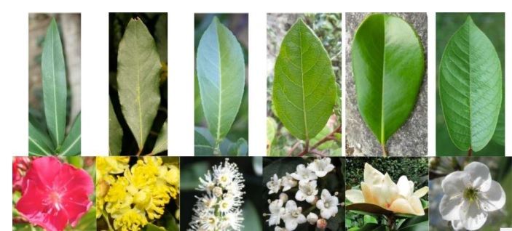
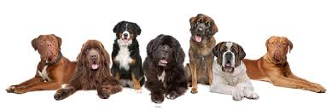
Fine-Grained Identification
Notes:
Fine-Grained Identification can be applied in different domains: plants, cars, dogs, etc.
It is very hard task for computers and humans too.
Fine-Grained Identification is very challenge because de similarity among classes.
Is a very important problem because make computer provide categorization into low level.
Is difficult to build the dataset... is necessary the human expert.

Slide 4
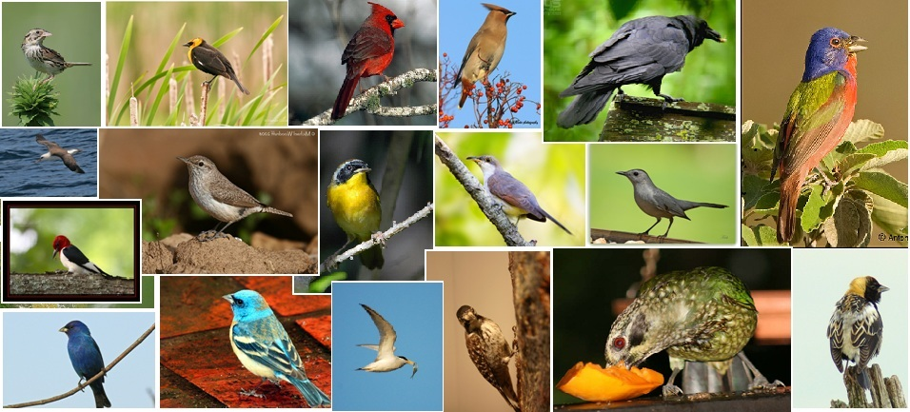
Why is Fine-Grained Identification Difficult?
What are the species of these birds?
Notes:
This work uses a fine-grained problem: bird species identification
Image Classification: Does the image contain an bird?
Image Identification: What specie is this bird?

Slide 5
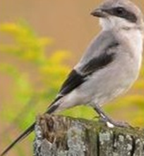
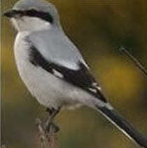
Why is Fine-Grained Identification Difficult?
What are the species of these birds?
Cardigan Welsh Corgi
2 images
2 species
Loggerhead Shrikes Great Grey Shrikes
Notes:
Challenges
Factors: lighting, pose, occlusion, clutter –Intra-class variation, variation of the background, etc.
Fine-Grained Identification is very challenge because de similarity among classes. Only some details difference.
This slide we have two images and two species.

Slide 6
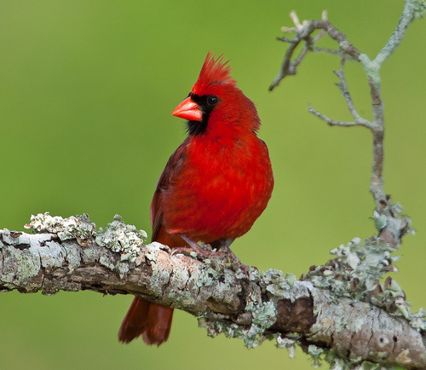
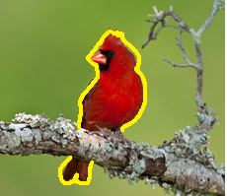
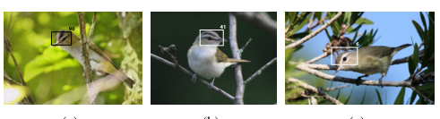
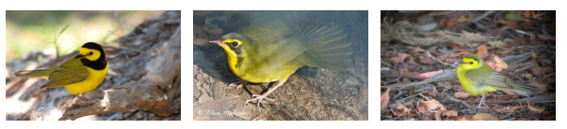

Main type of features
Image level label
Bounding box
Segmentaion
Parts
Poselet
Alignments
Notes:
Main strategies of collection features.
1 - Wah et al. (2011) - partes
2 - Zhang et al. (2012) - poselet
3 - Bo et al. (2013) – sparse coding - deep
4 - Zhang e Farrell (2013) - partes
5 - Branson et al. (2014) - partes
6 - Chai et al. (2013) – segmentação
7 - Gavves et al. (2013) – alinhamentos

Slide 7

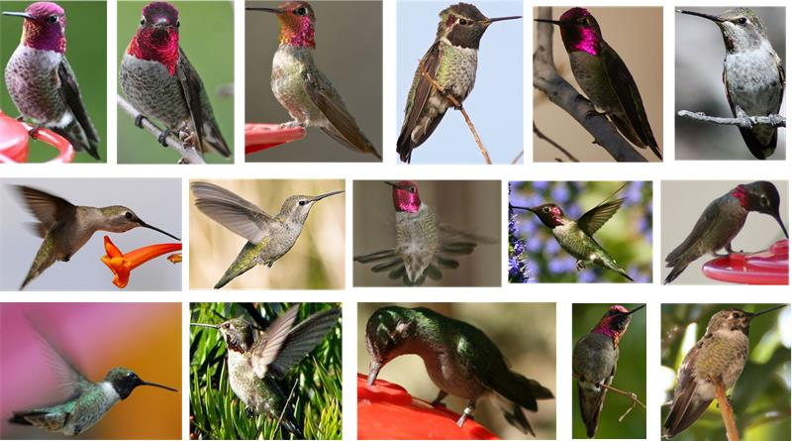
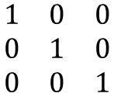
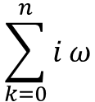
Why is Fine-Grained Identification Difficult?
$$\sum_{k=0}^{n}{i}ω$$
How to find correct features?
$$\begin{matrix}1 & 0 & 0 \\ 0 & 1 & 0 \\ 0 & 0 & 1\end{matrix}$$
How to learn correct features?
Deep or Shallow???
Anna Hummingbird
Notes:
We return to question: Why is Fine-Grained Identification Difficult?
The state of the art suggest two approaches: Deep or Shallow.
How to decide between Deep or Shallow?

Slide 8
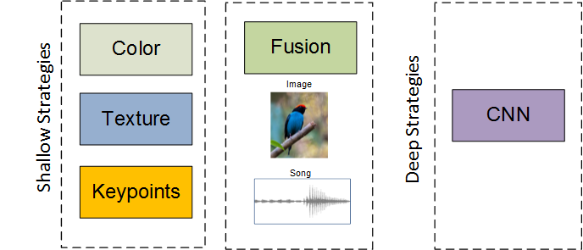
Approach
Overview
Notes:
This work makes a comparison to the problem of fine-grained automatic identification of bird species.

Slide 9
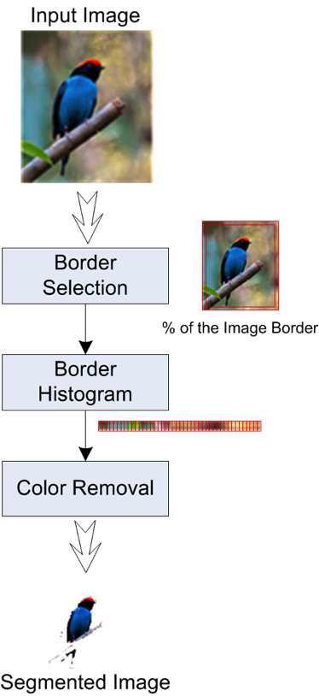
Approach
Color Overview – Color Segmentation
The segmentation step is based on the assumptions that:
  all available images are in colors
  the birds are at the central position in the images
  the bird edges are far away from the image borders.
The size of these strips is chosen to be a percentage, usually between 2% and 10% of the image horizontal and vertical dimensions.
These strips are scanned and the colors that are found into them are stored in a ranked list according to the color frequency.
The pixels that have similar colors to those found in the strips are labeled as background; otherwise they are labeled as ”bird”.
Notes:
At the beginning of the study we investigated one approach based solely on color. For this we propose a method of segmentation based on colors.

Slide 10
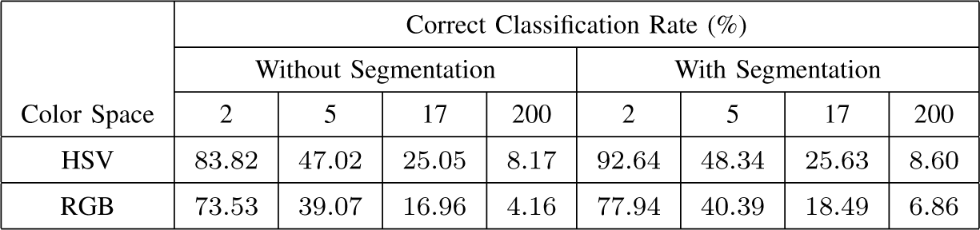
Experimental Results
Color Approach – Color Segmentation
Results for the HSV and RGB color spaces, with and without segmentation
Full feature vector + Single Classifier
Classifier: SVM - Radial Basis Function kernel – optimized
5-fold cross-validation procedure
Results = Accuracy on CUB-200
Notes:
Four point sixteen
Six point eight

Slide 11
Conclusions
Color Approach – Color Segmentation
It is clear the impact of the segmentation on the classification result.
Even if more than 70% of the pixels were correctly segmented, the impact on the bird species classification was not very impressive, ranging from 8.82% to 0.43%.
The segmentation does not play an important role in such a problem, in particular when the number of classes is high.
Based on the results presented in this study and the performance of the related works, we can assert that color features are interesting alternatives for bird species identification problem.
Notes:
From this point
because of low impact of the segmentation process
we decided to use only bounding box
why we will be sure that the bird in the image and less information is discarded
extract features only the inside of bounding box

Slide 12
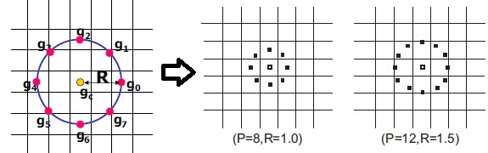
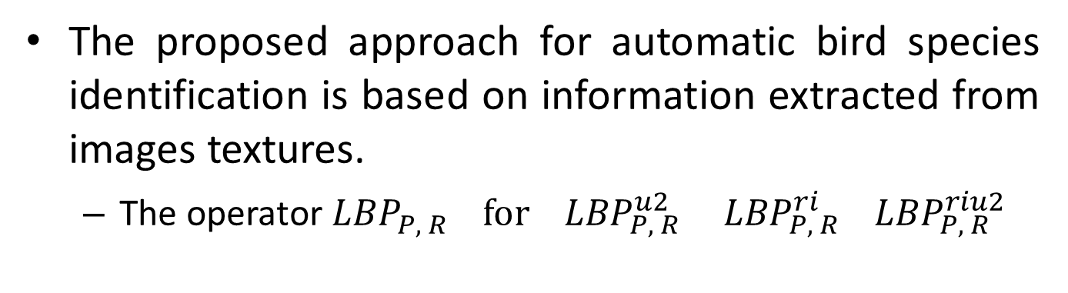
Approach
Texture Overview
LOCAL BINARY PATTERNS (LBP)
Circularly symmetric neighbor sets for different (P, R) [Ojala et al 2002].
The proposed approach for automatic bird species identification is based on information extracted from images textures.
  The operator ${LBP}_{P, R}^{ } for {LBP}_{P, R}^{u2 } { LBP}_{P, R}^{ri}$ ${ LBP}_{P, R}^{riu2 }$

Slide 13




Experimental Results
Texture Approach – LBP
$${LBP}_{P, R}^{u2 }$$
Results = Accuracy on CUB-200
$${ LBP}_{P, R}^{ri}$$
Results = Average for ${ LBP}_{ RGB}^{}$
$${ LBP}_{P, R}^{riu2}$$
Notes:
Rates for a few classes is high.
Class 200 however is low.
Three descriptors were tested
The results depend on the number of classes taken into account.
Look for 200 classes
It is important to remember that a real problem identification today there are over 9000 (nine thousand) species cataloged.

Slide 14
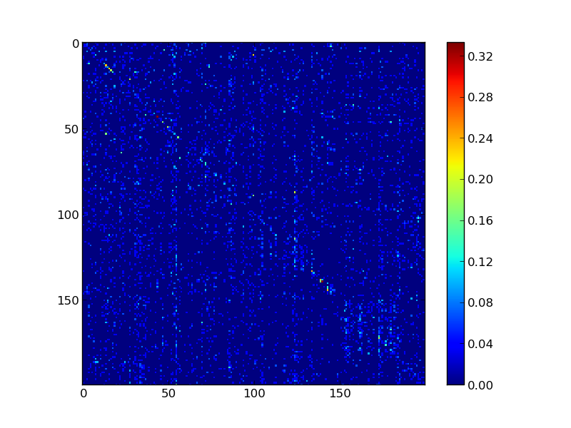
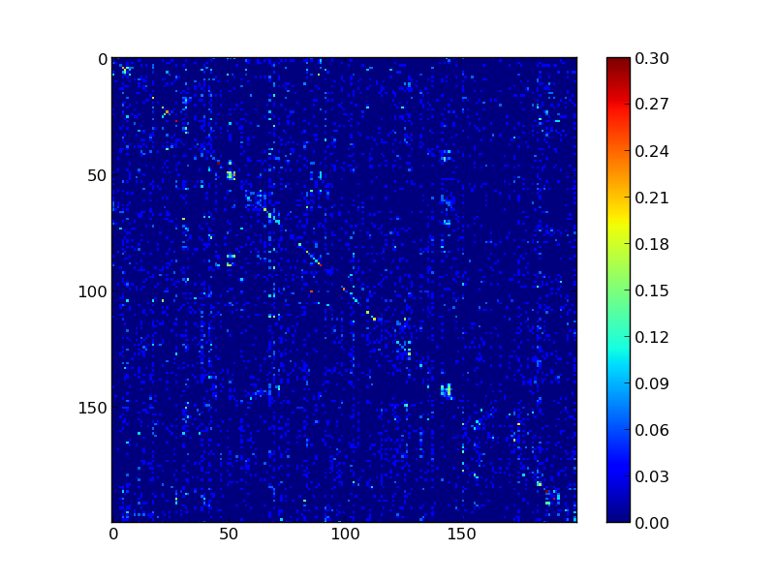
Experimental Results
Color and texture on CUB 200 2011

Slide 15
Conclusions
Texture Approach
The main contribution of this work an approach based on texture analysis that employs LBP to gray scale and color bird images from the CUB-200 dataset.
An interesting finding is that the color information seems not to be important as the number of classes increases since we have achieved similar results with gestures extracted from both grayscale and color images.
Notes:
main contribution: Texture Approach
Similarity results for gray scale and color

Slide 16
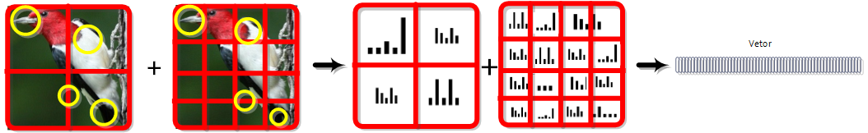
Approach
SIFT + Bok
Notes:
The size vector: twenty four thousand.

Slide 17
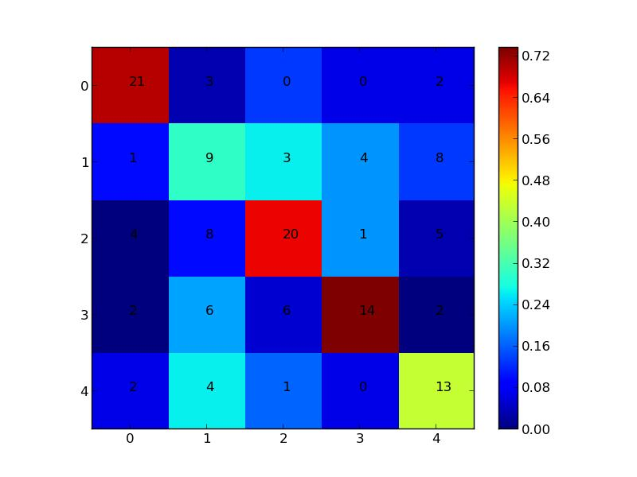
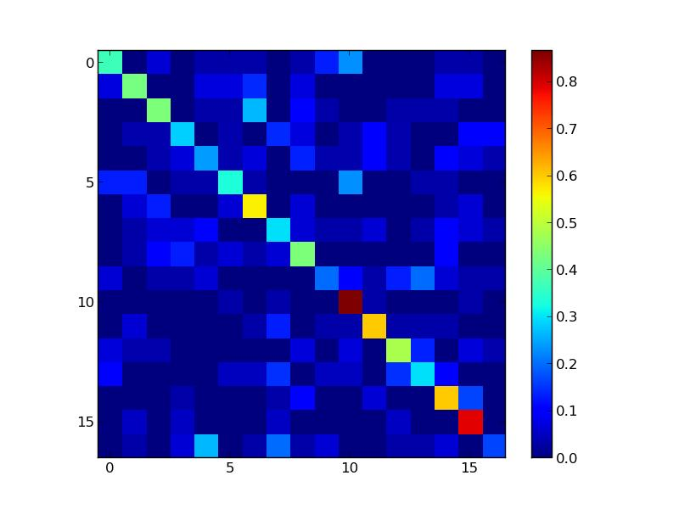
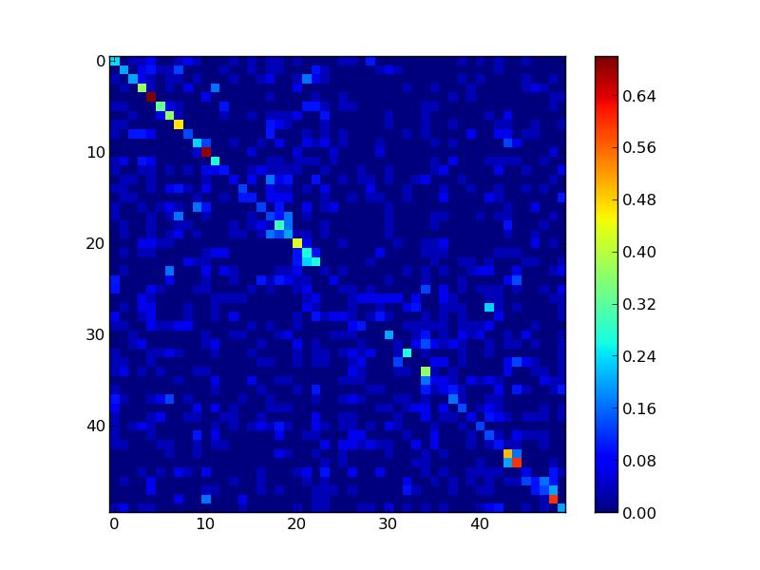
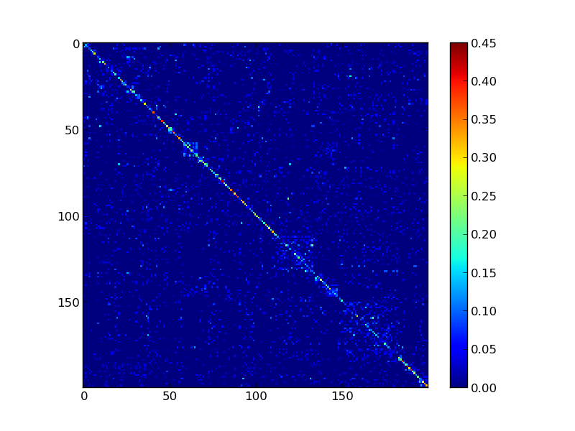
Experimental Results
SIFT + Bok
5 classes - accuracy 61,87%
17 classes - accuracy 43,07%
50 classes - accuracy 20,27%
200 classes - accuracy 18,29%
Notes:
Five
Seventeen
Fifty
Two hundred

Slide 18
Conclusions
SIFT + BoK
SIFT+Bok representation improved the results when compared to the best result of color or texture features.
Isolated features can not provide good results however, may be some complementary among them.
The SIFT+Bok results can be combined with bird songs.

Slide 19
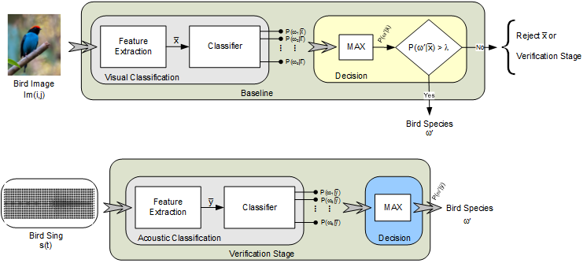
Approach
Fusion visual and acoustic
Notes:
The method can be described in four steps
1. visual classification
2. visual classification and rejection
3. acoustic classification
4. verification stage
Two fusion schemes are proposed:
samples rejected at the visual classification are re-classified using the acoustic data if it is available.
The decision is taken based solely on the verification stage;
samples rejected at the visual classification are re-classified using the acoustic data if it is available.

Slide 20
Experimental Results
Fusion visual and acoustic
Testing set at 0% rejection level and testing set at 10%, 30% and 50% rejection level.
N best hypothesis | Correct classification rate (%)
 | VISUAL | ACOUSTIC
TOP 1 | 27,03 | 45,97
TOP 2 | 36,76 | 57,98
TOP 4 | 48,92 | 72,04
TOP 6 | 57,77 | 79,62
TOP 8 | 64,05 | 84,36
TOP 10 | 68,72 | 86,97
STRATEGY | Reject Rate
 | 10% | 30% | 50%
Visual | 28,89 | 32,70 | 40,02
Visual and Acous. | 30,10 | 35,65 | 42,20
Visual and Acous. (Sum) | 29,71 | 35,22 | 41,90
Visual and Acous. (Prod) | 29,96 | 35,25 | 42,04
Visual and Acous. (Max) | 29,96 | 35,25 | 42,04
Notes:
Correct classification rates for the visual and acoustic classifiers on 1,480 images and 422 audio samples of the
testing set at 0% rejection level.
Correct classification rates for the fusion between visual and acoustic classifiers on the testing set at 10%, 30%
and 50% rejection level.
50 classes with an average of 30 images and 9 audio samples per class.
Further the output of both the visual and acoustic classifier is combined through conventional rules
such as sum, product and max.
The cost and gamma parameters were found by a 5-fold cross validation on the training
dataset. Pairwise coupling is used to handle multi-class classification.

Slide 21
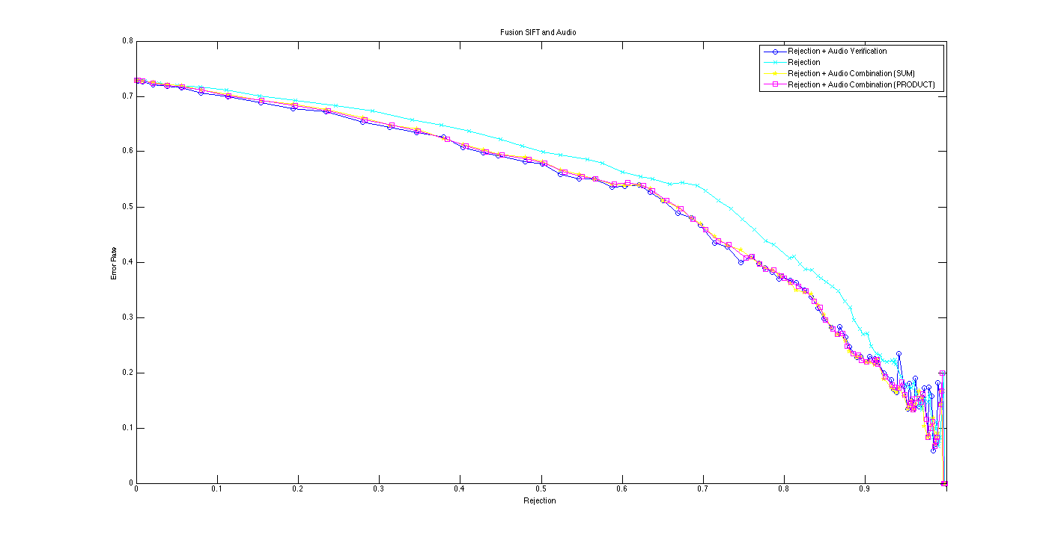
Experimental Results
Fusion visual and acoustic
Notes:
error and reject tradeoff

Slide 22
Conclusions
Fusion visual and acoustic
The acoustics features are relevant to improve image classification performance.
The proposed approach has show to be useful in situations where partial acoustic information is available.
Under the condition of a perfect rejection rule, that rejects only the wrongly classified images. The correct classification rate achieved is better.
The proposed approach could be improved.

Slide 23
Convolutional Neural Networks (CNN)
CNN Architecture.
Method is based on the extraction of random patches for training, and the combination of segments for test [Hafemann et al. 2014].
The experiments conducted to evaluate the CNN-based method considered CUB 200 2011 dataset.

Slide 24
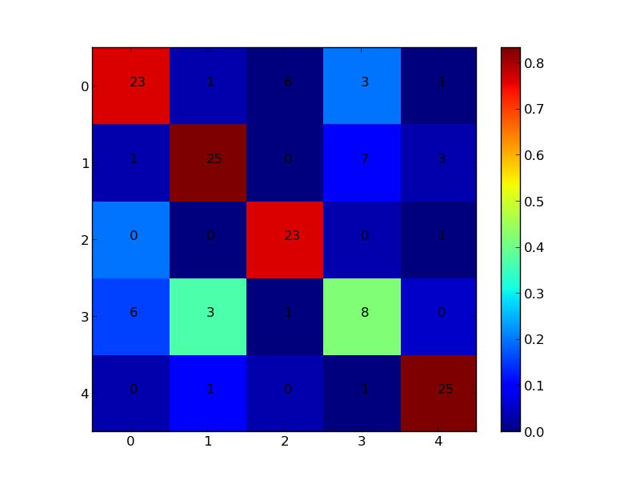
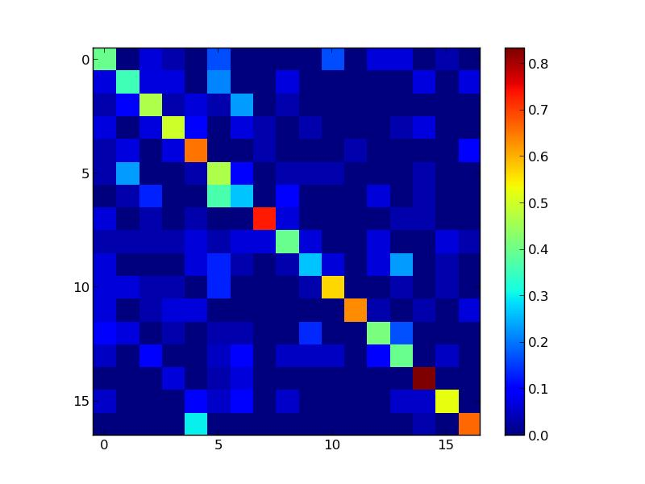
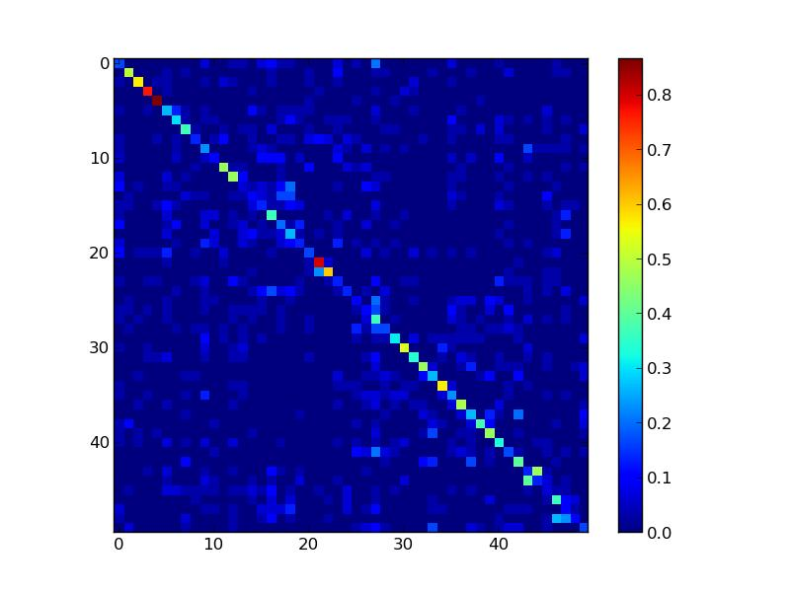
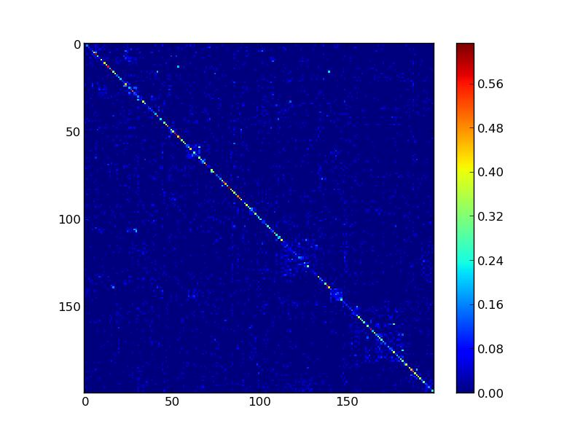
Results
CNN Approach
5 classes - accuracy 74,82%
17 classes - accuracy 50,96%
50 classes - accuracy 30,88%
200 classes - accuracy 23,50%

Slide 25
Conclusion
CNN Approach
Convolutional Neural Networks (CNN) have achieved the best results for 5, 17, 50 and 200 classes.
Our experiments demonstrate a clear advantage over deep representation.
Proposed approach could be improved.

Slide 26
Final Results
Best results for the individual classifiers.
Individual Classifiers | (%) Accuracy
2 classes - LBP RGB | 95
5 classes - CNN | 74,82
17 classes -CNN | 50,96
50 classes - CNN | 30,88
200 classes - CNN | 23,5

Slide 27
Fusion of label outputs
Majority Vote and Weighted Majority Vote for 7 classifiers
Combination of all classifiers
Dataset | (%) Accuracy | (%) Accuracy | (%) Accuracy MV | (%) Accuracy MV | (%) Accuracy WMV | (%) Accuracy WMV
 | Single best | Oracle | 50% + 1 | Moda/SB | W accuracy | W feature
2 classes | 95,00 | 100,00 | 98,33 | 98,33 | 95,00 | 95,00
5 classes | 74,82 | 100,00 | 62,59 | 80,58 | 20,86 | 20,86
17 classes | 50,96 | 100,00 | 19,62 | 58,85 | 9,38 | 9,38
50 classes | 30,88 | 58,11 | 1,08 | 28,92 | 7,56 | 7,56
200 classes | 23,50 | 45,96 | 0,41 | 23,50 | 1,65 | 2,14

Slide 28
Fusion of label outputs
Majority Vote and Weighted Majority Vote for 3 classifiers
Combination of the best three classifiers
Dataset | (%) Accuracy | (%) Accuracy | (%) A ccuracy MV | (%) Accuracy WMV | (%) Accuracy WMV
 | Single best | Oracle | Moda/SB | W accuracy | W feature
2 classes | 95,00 | 100,00 | 98,33 | 100,00 | 100,00
5 classes | 74,82 | 98,56 | 74,82 | 88,47 | 88,11
17 classes | 50,96 | 81,88 | 59,91 | 58,41 | 58,41
50 classes | 30,88 | 48,31 | 31,55 | 9,25 | 8,64
200 classes | 23,50 | 39,13 | 24,49 | 7,76 | 8,07
Notes:
After the experimental results.

Slide 29
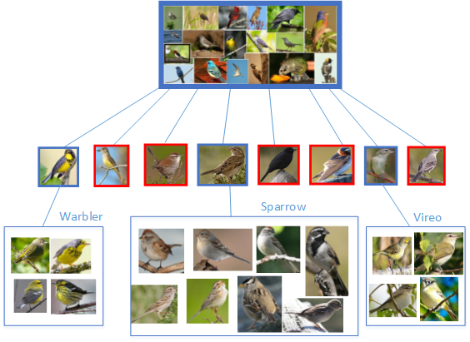
Error analysis
Notes:
Error analysis was also performed.

Slide 30
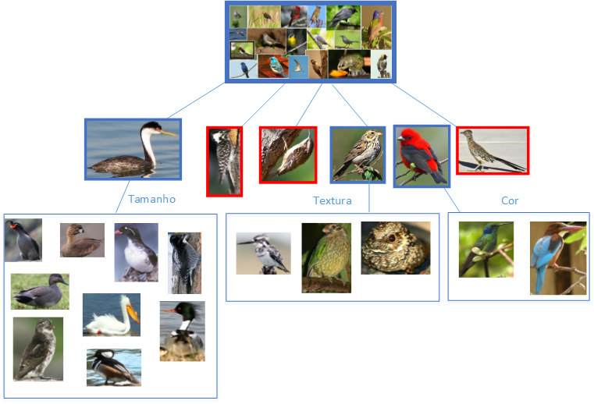
Successful predictions

Slide 31
Conclusion
Scenario 1: Shallow strategies.
Scenario 2: Deep strategy.
Comparison with the state of the art.
Notes:
Table results.
Deep strategy - were better - shallow strategies.

Slide 32
Notes:
Start in zero point six in 2010 achieve close to sixty.

Slide 33
1 - Wah et al. (2011)
2 - Zhang et al. (2012)
3 - Bo et al. (2013)
4 - Zhang e Farrell (2013)
5 - Branson et al. (2014)
6 - Chai et al. (2013)
7 - Gavves et al. (2013)
Notes:
Start in ten in 2011 achieve to sixty.
Despite our results are not competitive ... we have other contributions to problems and fine-grained visual identification
1 - Wah et al. (2011) - partes
2 - Zhang et al. (2012) - poselet
3 - Bo et al. (2013) – sparse coding - deep
4 - Zhang e Farrell (2013) - partes
5 - Branson et al. (2014) - partes
6 - Chai et al. (2013) – segmentação
7 - Gavves et al. (2013) – alinhamentos

Slide 34


Acknowledgments
This research has been supported by:
  CAPES
  Pontifical Catholic University of Paraná (PUCPR)
  Fundação Araucária.

Slide 35
References
Chatfield, K., K. Simonyan, A. Vedaldi, e A. Zisserman (2014). Return of the Devil in the Details: Delving Deep into Convolutional Nets.
Deng, J., J. Krause, e L. Fei-Fei (2013, June). Fine-Grained Crowdsourcing for Fine- Grained Recognition. 2013 IEEE Conference on Computer Vision and Pattern Recognition, 580-587.
Gavves, E., B. Fernando, C. Snoek, a.W.M. Smeulders, e T. Tuytelaars (2013, December). Fine-Grained Categorization by Alignments. 2013 IEEE International Conference on Computer Vision, 1713-1720.
Glotin, H., C. Clark, Y. Lecun, P. Dugan, X. Halkias, e J. Sueur (2013). The 1st International- Workshop on Machine Learning for Bioacoustics. In ICML (Ed.), ICML4B, Volume 1, Atlanta. 8, 41
Hafemann, L. G., L. S. Oliveira, e P. Cavalin (2014). Forest Species Recognition using Deep Convolutional Neural Networks. In International Conference on Pattern Recognition, Stockholm, Sweden, pp. 1103-1107.
Krizhevsky, A., I. Sutskever, e G. Hinton (2012). Imagenet classification with deep convolutional neural networks.
Lowe, D. G. (2004, November). Distinctive Image Features from Scale-Invariant Keypoints. International Journal of Computer Vision 60 (2), 91110.
Ojala, T. e T. Maenpaa (2001). A generalized Local Binary Pattern operator for multiresolution gray scale and rotation invariant texture classification.

Slide 36
Fine-Grained Visual Identification using Deep and Shallow Strategies

