Slide 1
Hierarchical Classifiers Combination for Automatic Musical Information Retrieval
Luis Gustavo Weigert Machado
luis.gustavo.weigert@gmail.com
Supervisor: Prof. PhD Alessandro Lameiras Koerich

Slide 2
Abstract
The most aggravating problem in the automatic classification of music is the true rates which is considerably low. We present a hierarchical combination of classifiers for increasing the strength in the musical styles classification employing different features extracted from music.
To solve this problem, some classification stages will be built with the aim of taking different features extracted from each music sample. In the first stage, the music samples will be trained with a neural network, and the probabilities results found will be evaluated to create thresholds set by the overall result, and also a list of confusion classes will be defined. Before, the confusion classes and the thresholds will be presented to the second stage to generate binary classifiers for each confusion using other features extracted of the same music. And finally, we will create a third stage to combine the results using the first and second stages.

Slide 3
MSD Dataset
The Million Song Dataset (MSD)
1 million contemporary popular music tracks with 280GB of data.
Metadata (trackid, artist, date).
Features (pitches, timbre and loudness) extracted using The Echonest API.

Slide 4
TU-WIEN MSD Benchmarks
Same audio samples of MSD linked with the unique IDs.
Mostly containing 30 or 60 seconds snippets.
Extracted several features, splitting into different datasets.
Ground Truth assignments provided by allmusic.com.
Genre Dataset (MAGD) 422,714 labels.
Top Genre Dataset (Top-MAGD) 406,427 labels.
Style Dataset(MASD) 273,936 labels.
Data splitted into train (90%, 80%, 66%, 50%) and test sets.
Stratified and non stratified datasetes: Artists, album and time filters. Avoiding to have the same characteristic in both the Training and test set.

Slide 5
TU-WIEN MSD Benchmarks
 | Feature Set | Extractor | Dim | Deriv.
1 | MFCCs | MARSAYS | 52
2 | Chroma | MARSAYS | 48
3 | Timbral | MARSAYS | 124
4 | MFCCs | jAudio | 26 | 156
5 | Low-level spectral features (Spectral Centroid, Spectral Rolloff Point, Spectral Flux,Compactness, and Spectral Variability, Root Mean Square, Zero Crossings, and Fraction of Low Energy Windows) | jAudio | 16 | 96
6 | Method of Moments | jAudio | 10 | 60
7 | Area Method of Moments | jAudio | 20 | 120
8 | Linear Predictive Coding | jAudio | 20 | 120
9 | Rhythm Patterns | rp extract | 1440
10 | Statistical Spectrum Descriptors | rp extract | 168
11 | Rhythm Histograms | rp extract | 60
12 | Modulation Frequency Variance Descriptor | rp extract | 420
13 | Temporal Statistical Spectrum Descriptors | rp extract | 1176
14 | Temporal Rhythm Histograms | rp extract | 420
Genre Name | Number of Songs
Big Band | 3,115
Blues Contemporary | 6,874
Country Traditional | 11,164
Dance | 15,114
Electronica | 10,987
Experimental | 12,139
Folk International | 9,849
Gospel | 6,974
Grunge Emo | 6,256
Hip Hop Rap | 16,100
Jazz Classic | 10,024
Metal Alternative | 14,009
Metal Death | 9,851
Metal Heavy | 10,784
Pop Contemporary | 13,624
Pop Indie | 18,138
Pop Latin | 7,699
Punk | 9,610
Reggae | 5,232
RnB Soul | 6,238
Rock Alternative | 12,717
Rock College | 16,575
Rock Contemporary | 16,530
Rock Hard | 13,276
Rock Neo Psychedelia | 11,057
Total | 273,936
Features extracted from the MSD samples.
Style Dataset(MASD)
Alexander Schindler, Rudolf Mayer, and Andreas Rauber. FACILITATING COMPREHENSIVE BENCHMARKING EXPERIMENTS ON THE MILLION SONG DATASET. ISMIR 2012

Slide 6
Datasets Used
Assignments : MSD Allmusic Guide Style (273,936 patterns).
Partitions: stratified 66% for train and 33% for test.
Features:
First Stage: Statistical Spectrum Descriptors (168 features).
Second Stage: Area Method of Moments (20 features).

Slide 7
Proposal
Training
First Stage:
Train a MLP NN with the style assignment outputs.
Calculate thresholds for each class using the output probabilities.
Find the most confused classes using the confusion matrix and also build a list of confused classes.
Second Stage:
Train SVM binary classifiers using the list of confused classes with a different dataset.
Third Stage:
Train binary classifiers, but now using 2-class MLP NN, with the same configuration of the second stage.
Evaluating
First Stage:
Get MAX₁ and MAX₂ output probabilities. Compare MAX₁ with the threshold for reject, classify or send to second stage.
Second Stage:
Get MAX₃. Search for a binary classifier, and compare with the threshold and MAX₁ for reject, classify or send to third stage.
Third Stage:
Get MAX₄ and combine the probabilities with MAX₃. Using the threshold to reject or classify.

Slide 8
Training the First Stage
Classifier: MLP Neural Network with 168 inputs, 100 hidden layer units, and 25 outputs.
Features: Statistical Spectrum Descriptors.
Partition: 66% of the dataset.

Slide 9
Training the First Stage
Train the dataset
Get arg(P_{1max}) and arg(P_{2max})
Calculate the thresholds λ using mean and standard deviation of the TP and FP output probabilities.
Generate the list of confused patterns analyzing the λ threshold.
Calculate the mean $\overline{M}$ of the misclassified patterns in the confusion matrix.
Generate the list of binary classifiers Ω analyzing the mean $\overline{M}$.

Slide 10
Training the Second Stage
Classifier: 2-class SVM with gridsearch to estimate the cost and γ parameters.
Features: Area Method of Moments.
Partition: 66% of the dataset.

Slide 11
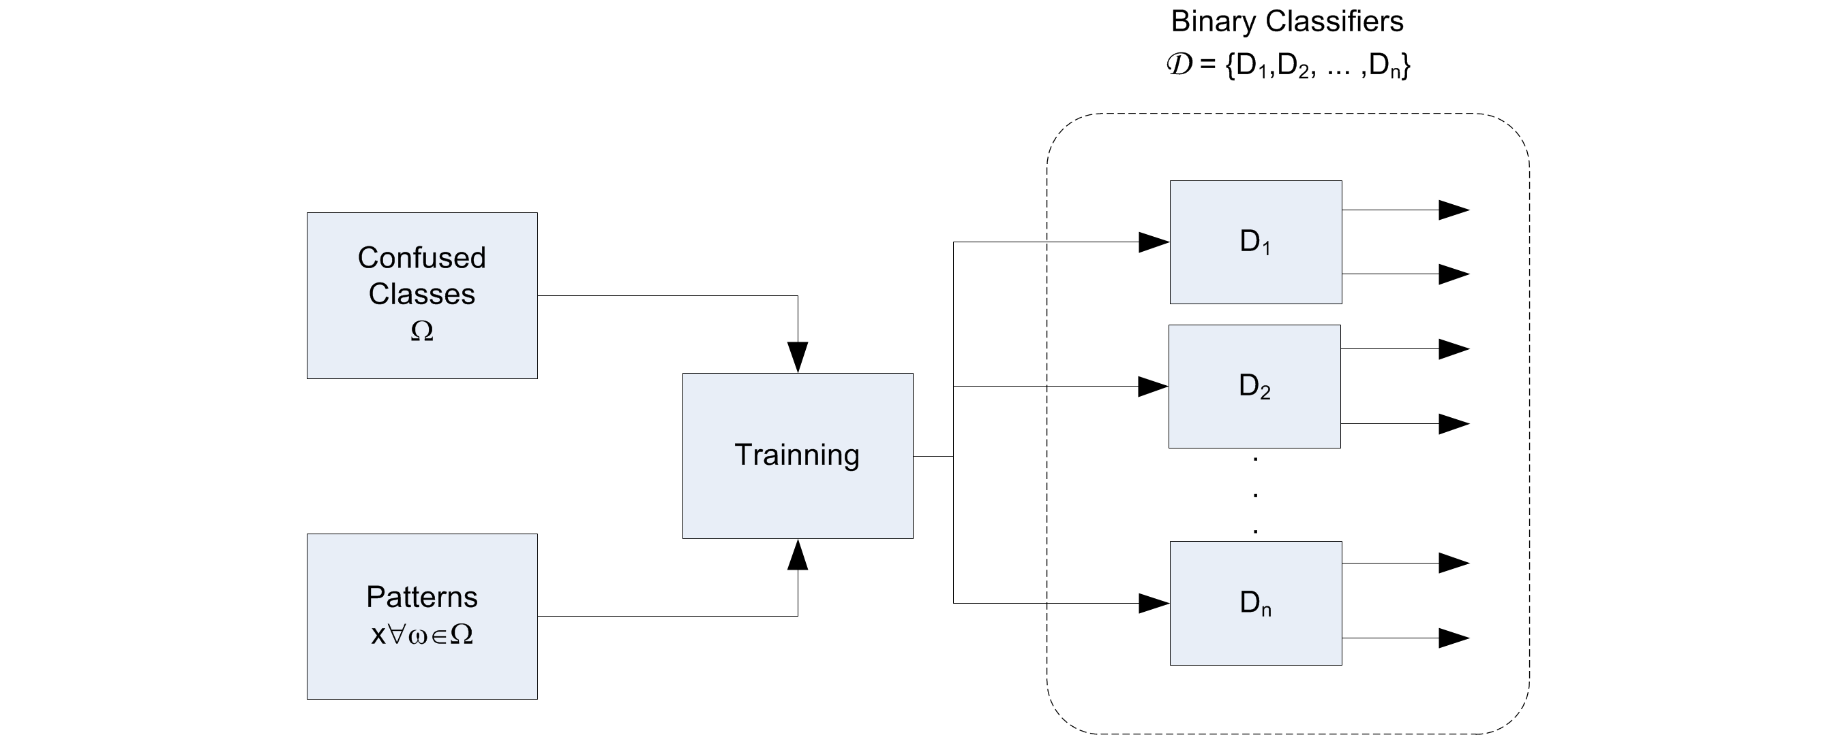
Training the Second Stage
Train each binary classifier in Ω (list of binary classifiers).

Slide 12
Training the Third Stage
Classifier: 2-class MLP NN, and 2-class SVM, the same used in the second stage.
Features: Area Method of Moments, same of the second stage.
2-class MLP NN: Train each binary classifier in Ω. The same as the Training method adopted in the second stage.

Slide 13
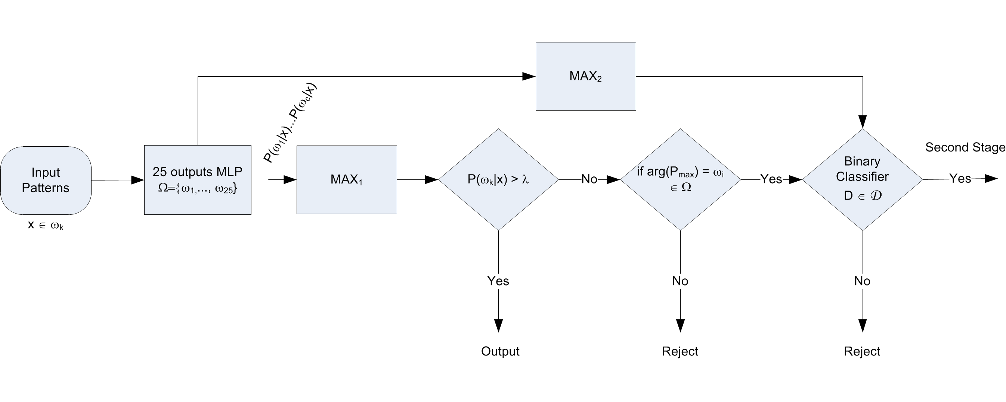
Evaluating the First Stage

Slide 14
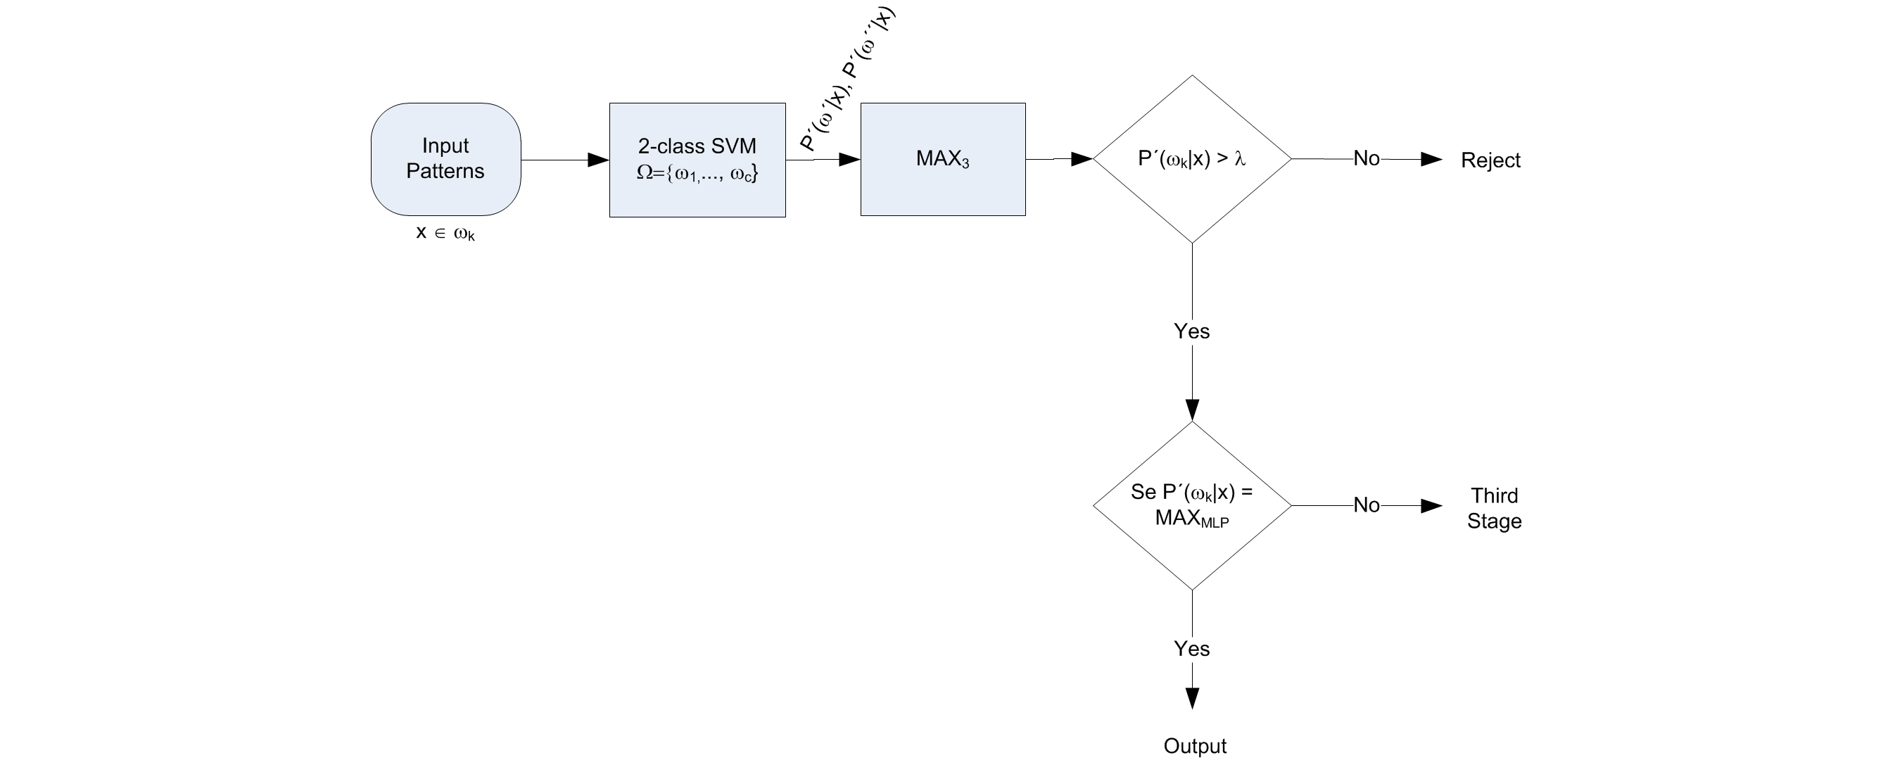
Evaluating the Second Stage

Slide 15
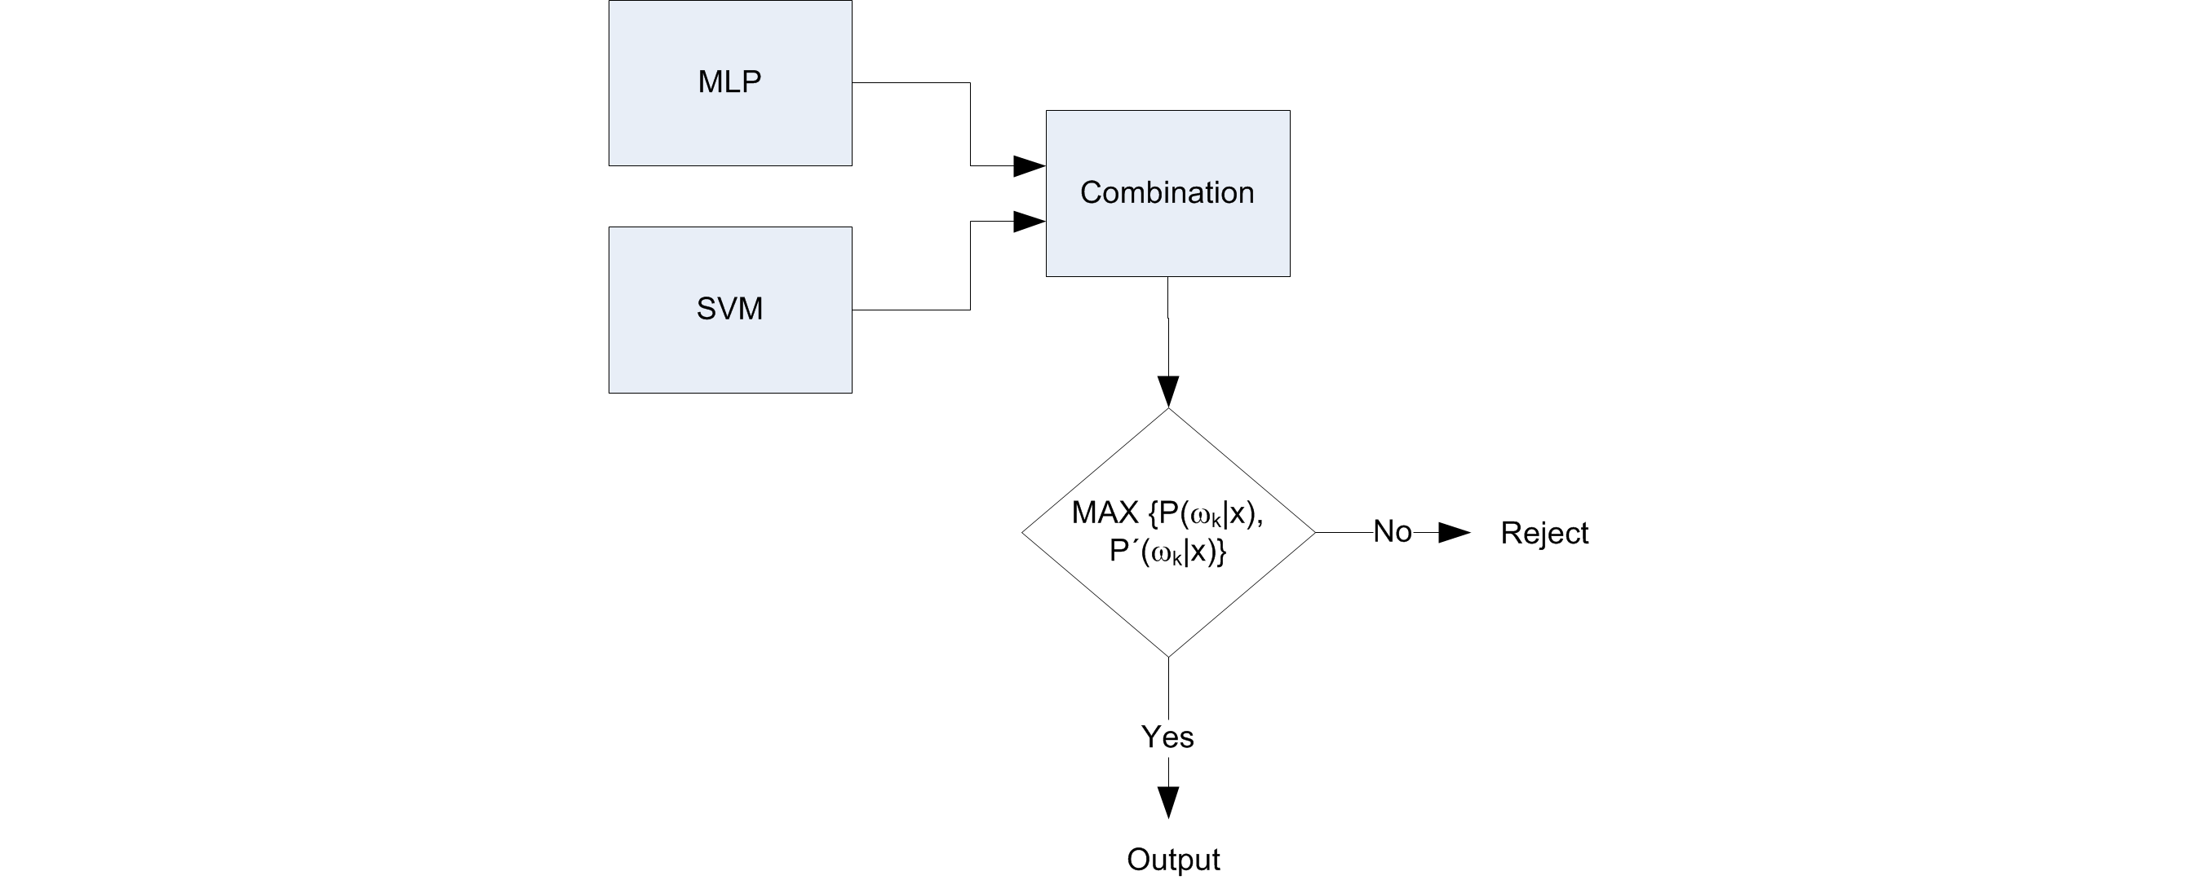
Evaluating the Third Stage

Slide 16
Results
 | First Stage (%) |  |  |  |  |  | Second Stage (%)
 | Classified |  | Rejected |  | Sent to 2nd Stage |  | Classified |  | Rejected |  | Sent to 3rd Stage
Class | TP | FP | TP | FP | TP | FP | TP | FP | TP | FP | TP | FP
Big Band | 0,000 | 0,345 | 0,000 | 0,332 | 0,000 | 0,463 | 0,000 | 0,155 | 0,005 | 0,000 | 0,303 | 0,000
Blues Contemporary | 0,128 | 0,575 | 0,031 | 0,854 | 0,063 | 0,862 | 0,005 | 0,263 | 0,029 | 0,000 | 0,627 | 0,000
Country Traditional | 1,430 | 0,706 | 0,188 | 0,589 | 0,419 | 0,742 | 0,026 | 0,297 | 0,025 | 0,000 | 0,801 | 0,012
Dance | 0,481 | 2,476 | 0,159 | 0,655 | 0,229 | 1,506 | 0,130 | 0,325 | 0,154 | 0,000 | 0,699 | 0,427
Electronica | 0,099 | 1,648 | 0,091 | 0,918 | 0,105 | 1,121 | 0,028 | 0,331 | 0,097 | 0,000 | 0,770 | 0,000
Experimental | 0,023 | 1,408 | 0,013 | 1,332 | 0,019 | 1,623 | 0,009 | 0,613 | 0,034 | 0,000 | 0,987 | 0,000
Folk International | 0,011 | 1,217 | 0,012 | 0,879 | 0,001 | 1,481 | 0,000 | 0,454 | 0,056 | 0,000 | 0,972 | 0,000
Gospel | 0,000 | 1,211 | 0,000 | 0,478 | 0,000 | 0,862 | 0,000 | 0,254 | 0,038 | 0,000 | 0,570 | 0,000
Grunge Emo | 0,000 | 1,250 | 0,000 | 0,401 | 0,000 | 0,630 | 0,000 | 0,336 | 0,013 | 0,000 | 0,281 | 0,000
Hip Hop Rap | 4,465 | 0,289 | 0,243 | 0,123 | 0,514 | 0,259 | 0,051 | 0,110 | 0,000 | 0,066 | 0,535 | 0,011
Jazz Classic | 0,595 | 0,524 | 0,356 | 0,582 | 0,532 | 1,070 | 0,151 | 0,360 | 0,050 | 0,000 | 0,992 | 0,049
Metal Alternative | 2,075 | 1,074 | 0,196 | 0,565 | 0,529 | 0,683 | 0,397 | 0,177 | 0,016 | 0,000 | 0,548 | 0,074
Metal Death | 0,964 | 1,267 | 0,017 | 0,304 | 0,549 | 0,509 | 0,104 | 0,314 | 0,002 | 0,000 | 0,631 | 0,008
Metal Heavy | 0,271 | 1,937 | 0,024 | 0,491 | 0,094 | 1,098 | 0,067 | 0,493 | 0,009 | 0,000 | 0,350 | 0,274
Pop Contemporary | 0,413 | 2,308 | 0,031 | 0,624 | 0,203 | 1,410 | 0,049 | 0,379 | 0,108 | 0,000 | 0,828 | 0,249
Pop Indie | 0,838 | 1,936 | 0,459 | 1,124 | 0,195 | 2,051 | 0,129 | 0,666 | 0,055 | 0,000 | 0,946 | 0,450
Pop Latin | 0,078 | 1,172 | 0,019 | 0,605 | 0,039 | 0,897 | 0,000 | 0,204 | 0,069 | 0,000 | 0,663 | 0,000
Punk | 0,491 | 1,341 | 0,103 | 0,557 | 0,168 | 0,854 | 0,012 | 0,519 | 0,012 | 0,000 | 0,458 | 0,021
Reggae | 0,026 | 0,973 | 0,014 | 0,434 | 0,012 | 0,454 | 0,000 | 0,110 | 0,041 | 0,000 | 0,315 | 0,000
RnB Soul | 0,000 | 0,995 | 0,000 | 0,449 | 0,000 | 0,844 | 0,000 | 0,239 | 0,039 | 0,000 | 0,566 | 0,000
Rock Alternative | 0,000 | 2,209 | 0,000 | 0,964 | 0,000 | 1,468 | 0,000 | 0,547 | 0,028 | 0,000 | 0,893 | 0,000
Rock College | 0,079 | 2,501 | 0,004 | 1,488 | 0,025 | 1,949 | 0,009 | 0,750 | 0,034 | 0,000 | 1,182 | 0,000
Rock Contemporary | 1,152 | 1,821 | 0,143 | 0,792 | 0,394 | 1,730 | 0,278 | 0,262 | 0,074 | 0,000 | 0,457 | 1,053
Rock Hard | 0,161 | 1,798 | 0,012 | 1,194 | 0,111 | 1,581 | 0,075 | 0,642 | 0,042 | 0,000 | 0,933 | 0,000
Rock Neo Psychedelia | 0,000 | 1,990 | 0,000 | 0,796 | 0,000 | 1,261 | 0,000 | 0,563 | 0,031 | 0,000 | 0,666 | 0,000
Total | 13,780 | 34,968 | 2,116 | 17,529 | 4,200 | 27,408 | 1,518 | 9,364 | 1,061 | 0,066 | 16,974 | 2,625
The results are presented in percentage relative to the amount test patterns.
Classified TP: Samples classified correctly.
Classified FP: Samples classified wrong.
Rejected TP: Samples rejected and would be classified wrong.
Rejected FP: Samples rejected but would be classified right.
Second Stage TP: Samples sent to the second stage and would be classified wrong.
Second Stage FP: Samples sent to the second stage but would be classified right.
Third Stage TP: Samples sent to the third stage and would be classified wrong.
Third Stage FP: Samples sent to the third stage but would be classified right.

