Slide 1
Big Text:
from Language (Names and Phrases)
to Knowledge (Entities and Relations)
Gerhard Weikum
Max Planck Institute for Informatics
Saarbrücken, Germany
http://www.mpi-inf.mpg.de/~weikum/

Slide 2















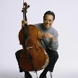





From Natural-Language Text to Knowledge
more knowledge, analytics, insight
knowledge
acquisition
Web
Contents
Knowledge
intelligent
interpretation

Slide 3
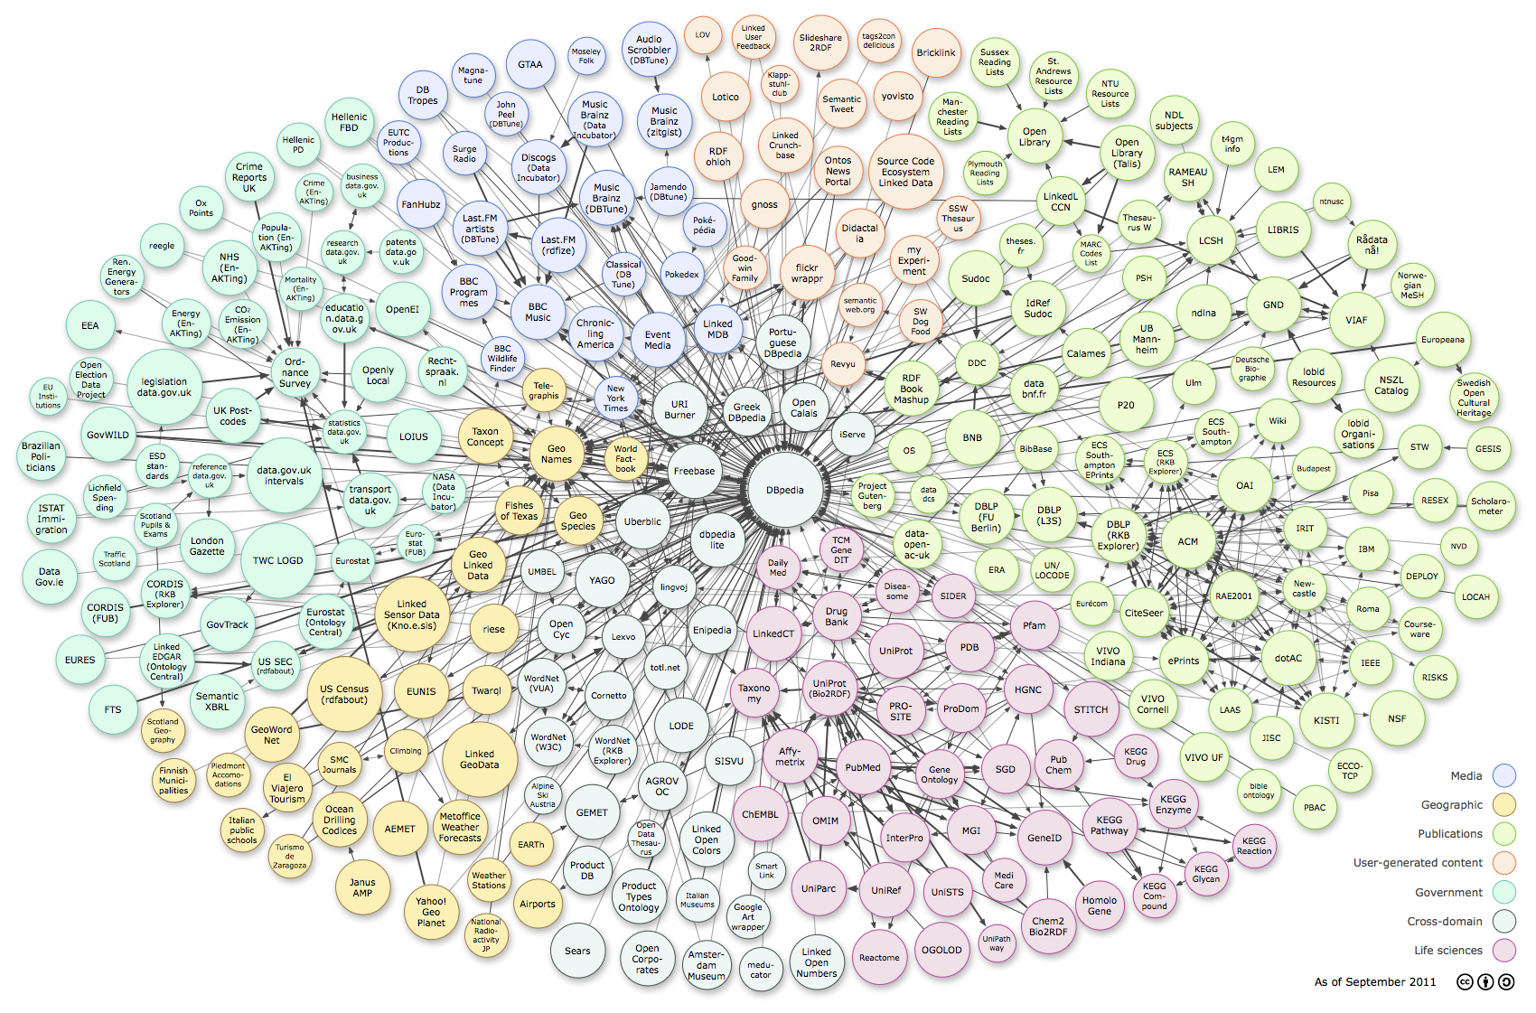



















Web of Data & Knowledge (Linked Open Data)
> 50 Bio. subject-predicate-object triples from > 1000 sources
ReadTheWeb
Cyc
SUMO
BabelNet
TextRunner/
ReVerb
WikiTaxonomy/
WikiNet
ConceptNet 5
http://richard.cyganiak.de/2007/10/lod/lod-datasets_2011-09-19_colored.png

Slide 4
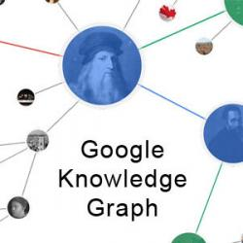
Web of Data & Knowledge
> 50 Bio. subject-predicate-object triples from > 1000 sources
4M entities in
250 classes
500M facts for
6000 properties
live updates
600M entities in
15000 topics
20B facts
10M entities in
350K classes
120M facts for
100 relations
100 languages
95% accuracy
40M entities in
15000 topics
1B facts for
4000 properties
core of Google
Knowledge Graph

Slide 5
Web of Data & Knowledge
> 50 Bio. subject-predicate-object triples from > 1000 sources
Bob_Dylan type songwriter
Bob_Dylan type civil_rights_activist
songwriter subclassOf artist
Bob_Dylan composed Hurricane
Hurricane isAbout Rubin_Carter
Steve_Jobs marriedTo Sara_Lownds
validDuring [Sep-1965, June-1977]
Bob_Dylan knownAs „voice of a generation“
Steve_Jobs „was big fan of“ Bob_Dylan
Bob_Dylan „briefly dated“ Joan_Baez
taxonomic knowledge
factual knowledge
temporal knowledge
terminological knowledge
evidence & belief knowledge

Slide 6
Knowledge for Intelligent Applications
Enabling technology for:
  disambiguation
  in written & spoken natural language
  deep reasoning
  (e.g. QA to win quiz game)
  machine reading
  (e.g. to summarize book or corpus)
  semantic search
  in terms of entities&relations (not keywords&pages)
  entity-level linkage
  for Big Data & Big Text analytics

Slide 7
Use-Case: Semantic Search
Politicians who are also scientists?
European composers who have won film music awards?
Internet companies founded by Brazilian professors?
Enzymes that inhibit HIV?
Influenza drugs for teens with high blood pressure?
...

Slide 8

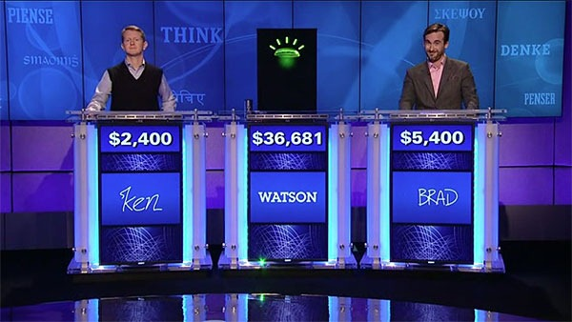


Use-Case: Question Answering
This town is known as "Sin City" & its downtown is "Glitter Gulch"
Q: Sin City ?
→ movie, graphical novel, nickname for city, …
A: Vegas ? Vega ? Strip ?
→ Vega (star), Suzanne Vega, Vincent Vega, Las Vegas, …
→ comic strip, striptease, Las Vegas Strip, …
This American city has two airports
named after a war hero and a WW II battle
question
classification &
decomposition
knowledge
back-ends
D. Ferrucci et al.: Building Watson. AI Magazine, Fall 2010.
IBM Journal of R&D 56(3/4), 2012: This is Watson.

Slide 9







Big Text Analytics: Who Covered Whom?
in different language, country, key, …
with more sales, awards, media buzz, …
.....
1000‘s of Databases
100 Mio‘s of Web Tables
100 Bio‘s of Web &
Social Media Pages
Musician Original Title
Elvis Presley Frank Sinatra My Way
Robbie Williams Frank Sinatra My Way
Sex Pistols Frank Sinatra My Way
Frank Sinatra Claude Francois Comme d‘Habitude
Claudia Leitte Bruno Mars Famo$a (Billionaire)
. . . . . . . . . . . . . . .

Slide 10
Big Text Analytics: Who Covered Whom?
in different language, country, key, …
with more sales, awards, media buzz, …
.....
1000‘s of Databases
100 Mio‘s of Web Tables
100 Bio‘s of Web &
Social Media Pages
Musician PerformedTitle
Musician CreatedTitle
Sex Pistols My Way
Frank Sinatra My Way
Claudia Leitte Famo$a
Petula Clark Boy from Ipanema
Francis Sinatra My Way
Paul Anka My Way
Bruno Mars Billionaire
Astrud Gilberto Garota de Ipanema
Name Show
Petula C. Muppets
Claudia L. FIFA 2014
Name Group
Sid Vicious Sex Pistols
Bono U2

Slide 11

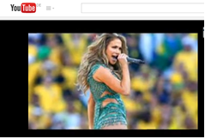
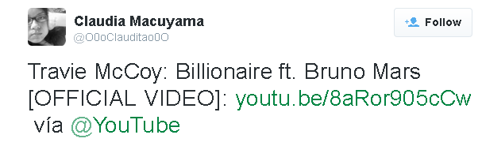
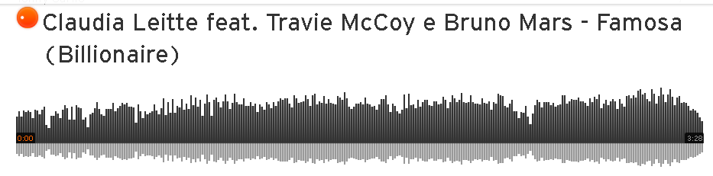
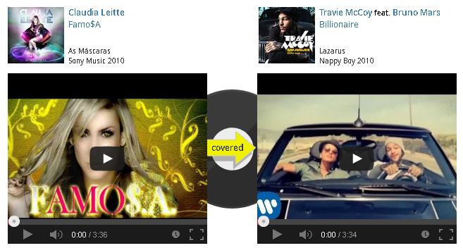
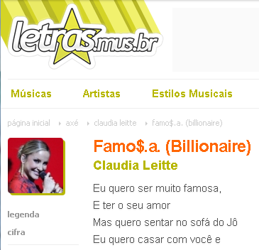
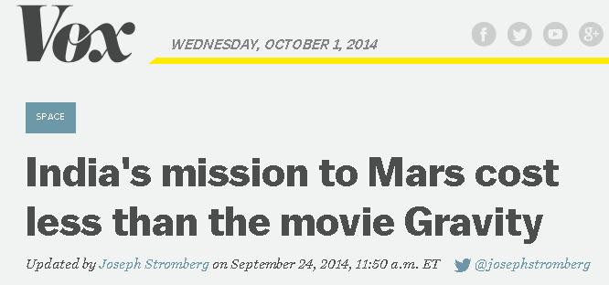
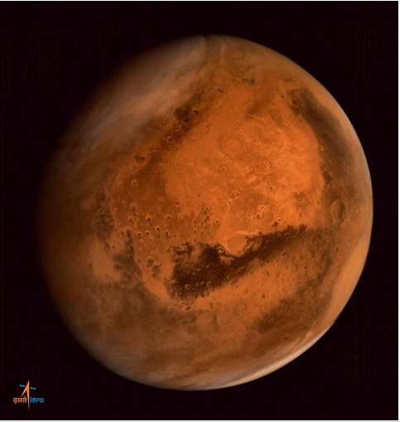

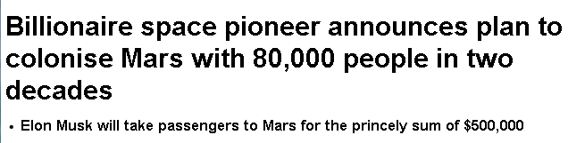
Big Text Analytics: Who Covered Whom?
in different language, country, key, …
with more sales, awards, media buzz, …
.....
1000‘s of Databases
100 Mio‘s of Web Tables
100 Bio‘s of Web &
Social Media Pages
Big Data & Big Text
Volume
Velocity
Variety
Veracity
Big Data
Volume
Velocity
Variety
Veracity
Musician PerformedTitle
Musician CreatedTitle
Sex Pistols My Way
Frank Sinatra My Way
Claudia Leitte Famo$a
Petula Clark Boy from Ipanema
Francis Sinatra My Way
Paul Anka My Way
Bruno Mars Billionaire
Astrud Gilberto Garota de Ipanema

Slide 12
Big Data & Big Text Analytics
Entertainment:
Who covered which other singer?
Who influenced which other musicians?
Health:
Drugs (combinations) and their side effects
Politics:
Politicians‘ positions on controversial topics
and their involvement with industry
Business:
Customer opinions on small-company products,
gathered from social media
Culturomics:
Trends in society, cultural factors, etc.
General Design Pattern:
Identify relevant contents sources
Identify entities of interest & their relationships
Position in time & space
Group and aggregate
Find insightful patterns & predict trends

Slide 13
Outline

Introduction
Lovely NERD
The New Chocolate
The Dark Side
Conclusion

Slide 14
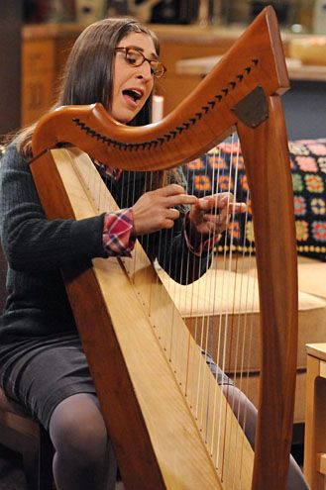
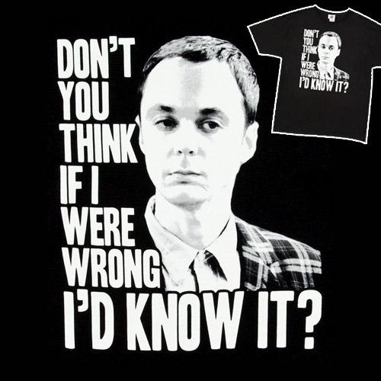


Lovely NERD

Slide 15

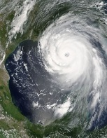

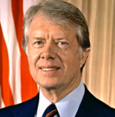
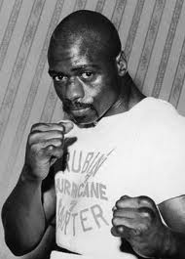
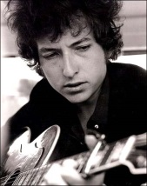
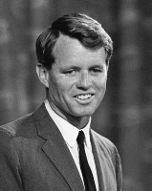
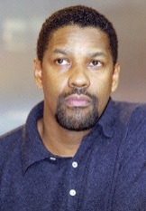
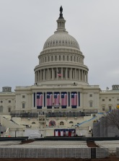
Named Entity Recognition & Disambiguation
(NERD)
Hurricane,
about Carter,
is on Bob‘s
Desire.
It is played in
the film with
Washington.
contextual similarity:
mention vs. entity
(bag-of-words,
language model)
prior popularity
of name-entity pairs

Slide 16
Named Entity Recognition & Disambiguation
(NERD)
Coherence of entity pairs:
semantic relationships
shared types (categories)
overlap of Wikipedia links
Hurricane,
about Carter,
is on Bob‘s
Desire.
It is played in
the film with
Washington.

Slide 17
Named Entity Recognition & Disambiguation
Coherence: (partial) overlap
of (statistically weighted)
entity-specific keyphrases
racism protest song
boxing champion
wrong conviction
Hurricane,
about Carter,
is on Bob‘s
Desire.
It is played in
the film with
Washington.
racism victim
middleweight boxing
nickname Hurricane
falsely convicted
Grammy Award winner
protest song writer
film music composer
civil rights advocate
Academy Award winner
African-American actor
Cry for Freedom film
Hurricane film

Slide 18
Named Entity Recognition & Disambiguation
Hurricane,
about Carter,
is on Bob‘s
Desire.
It is played in
the film with
Washington.
KB provides building blocks:
name-entity dictionary,
relationships, types,
text descriptions, keyphrases,
statistics for weights
NED algorithms compute
mention-to-entity mapping
over weighted graph of candidates
by popularity & similarity & coherence

Slide 19
Joint Mapping
e1
m1
50
30
50
20
e2
30
10
10
m2
e3
90
100
m3
30
e4
80
20
90
100
e5
90
m4
5
30
e6
Build mention-entity graph or joint-inference factor graph
from knowledge and statistics in KB
Compute high-likelihood mapping (ML or MAP) or
dense subgraph (with high total edge weight) such that:
each m is connected to exactly one e (or at most one e)
19

Slide 20
Coherence Graph Algorithm
[J. Hoffart et al.:
EMNLP‘11, VLDB‘12]
140
e1
m1
50
30
50
20
180
e2
30
10
10
m2
50
e3
90
100
m3
30
470
e4
80
20
90
100
145
e5
90
m4
5
30
230
e6
Compute dense subgraph to
maximize min weighted degree among entity nodes
such that:
each m is connected to exactly one e (or at most one e)
Approx. algorithms (greedy, randomized, …), hash sketches, …
82% precision on CoNLL‘03 benchmark
Open-source software & online service AIDA
http://www.mpi-inf.mpg.de/yago-naga/aida/
D5 Overview May 14, 2013
20

Slide 21
NERD Online Tools
  J. Hoffart et al.: EMNLP 2011, VLDB 2011
  https://d5gate.ag5.mpi-sb.mpg.de/webaida/
  P. Ferragina, U. Scaella: CIKM 2010
  http://tagme.di.unipi.it/
  R. Isele, C. Bizer: VLDB 2012
  http://spotlight.dbpedia.org/demo/index.html
  D. Milne, I. Witten: CIKM 2008
  http://wikipedia-miner.cms.waikato.ac.nz/demos/annotate/
  L. Ratinov, D. Roth, D. Downey, M. Anderson: ACL 2011
  http://cogcomp.cs.illinois.edu/page/demo_view/Wikifier
  Reuters Open Calais: http://viewer.opencalais.com/
  Alchemy API: http://www.alchemyapi.com/api/demo.html

Slide 22
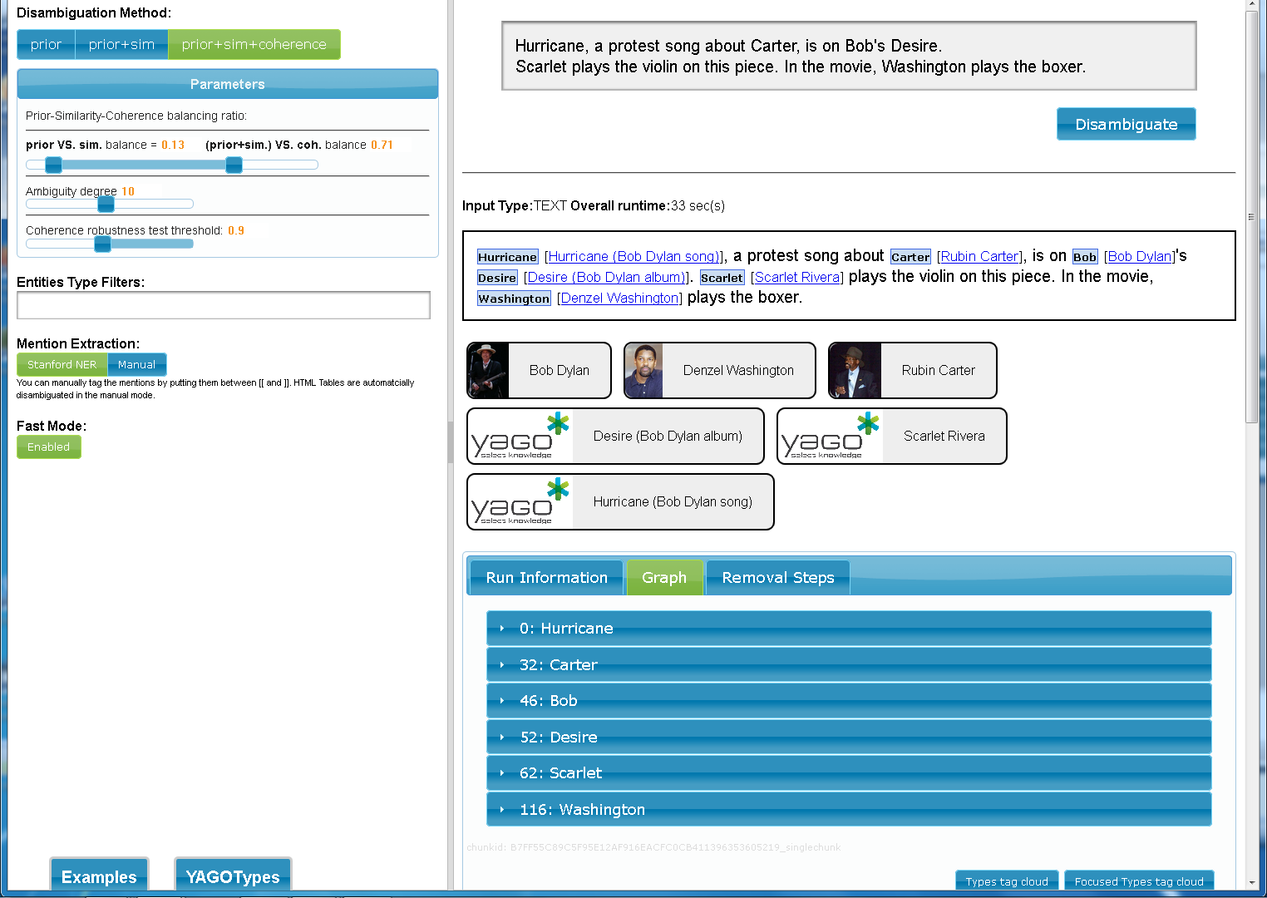
NERD at Work
https://gate.d5.mpi-inf.mpg.de/webaida/

Slide 23
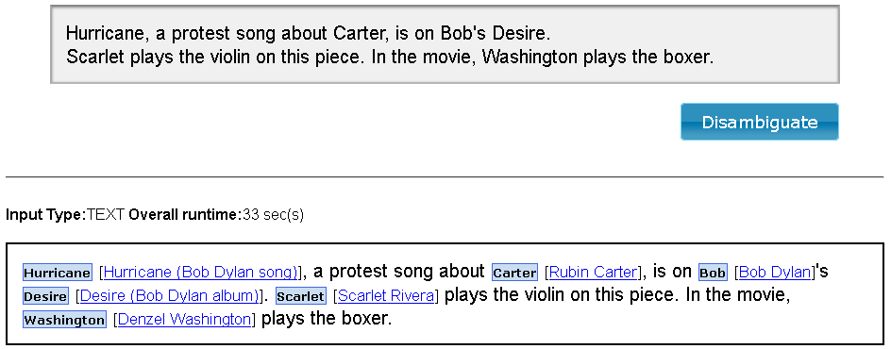
NERD at Work
https://gate.d5.mpi-inf.mpg.de/webaida/

Slide 24
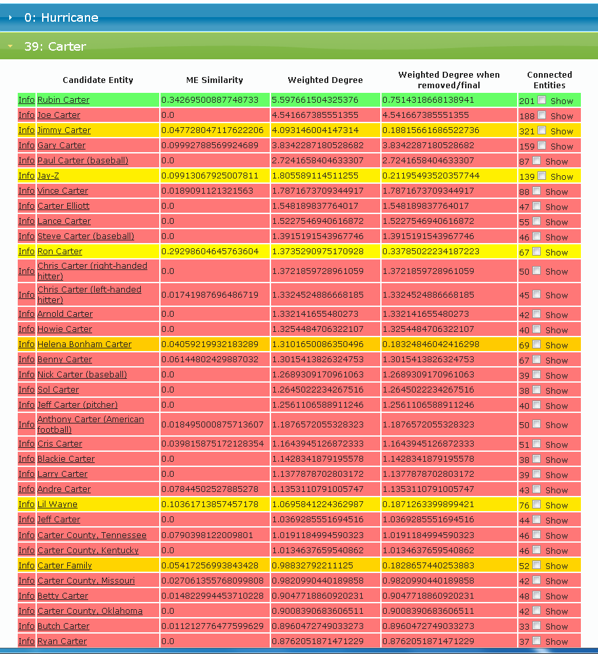
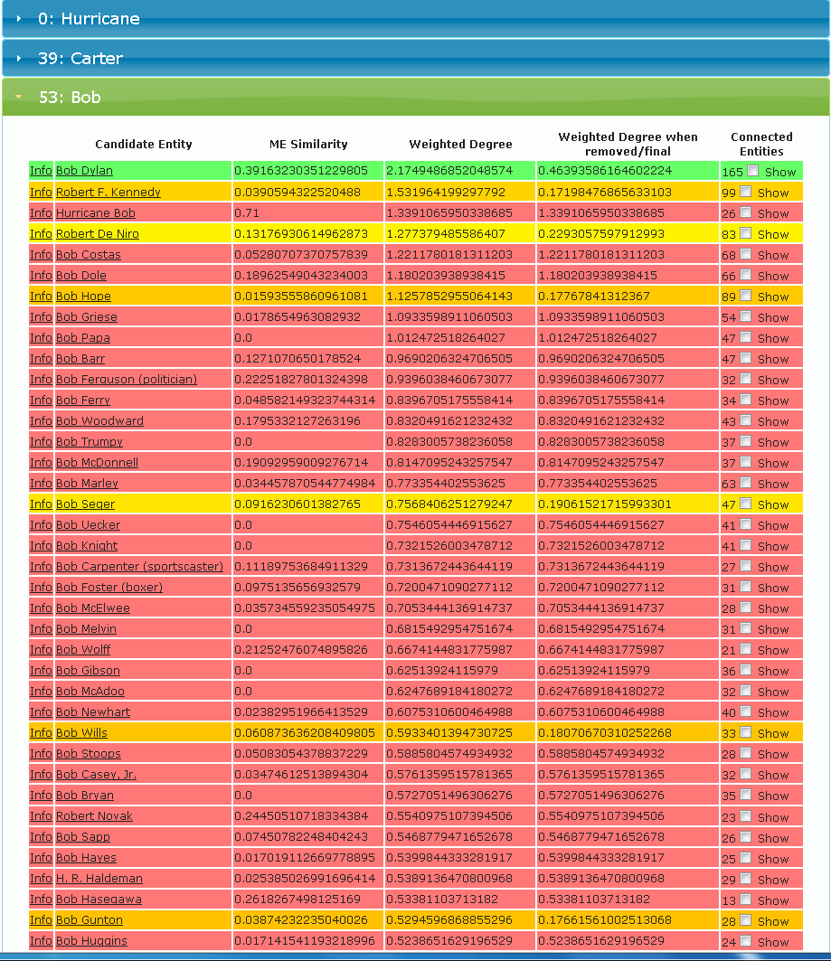
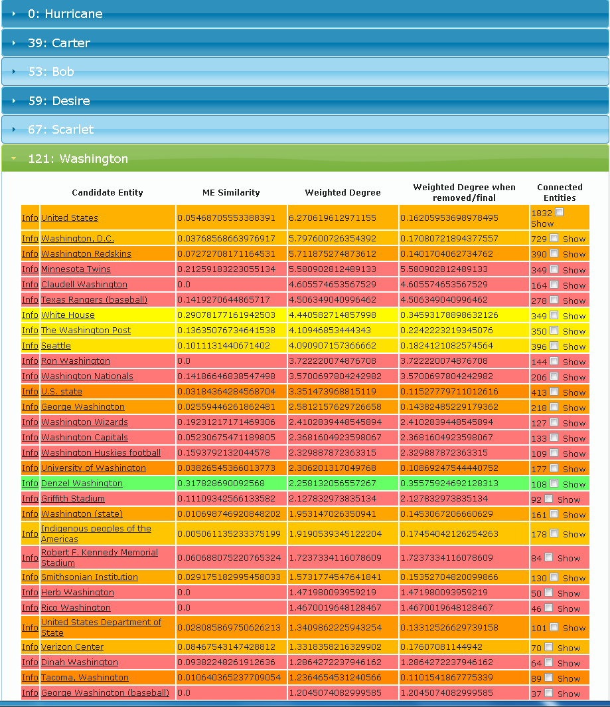
NERD at Work
https://gate.d5.mpi-inf.mpg.de/webaida/

Slide 25
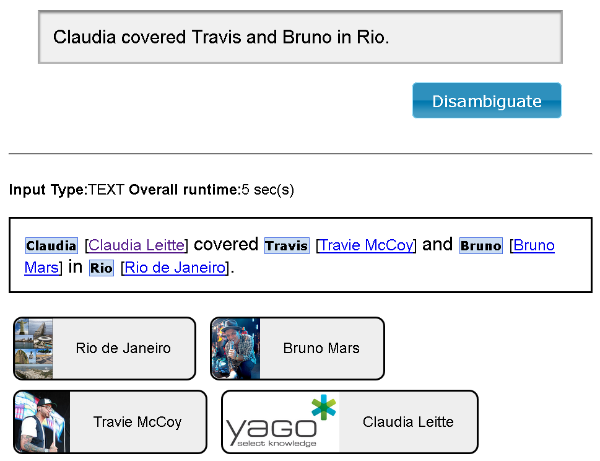
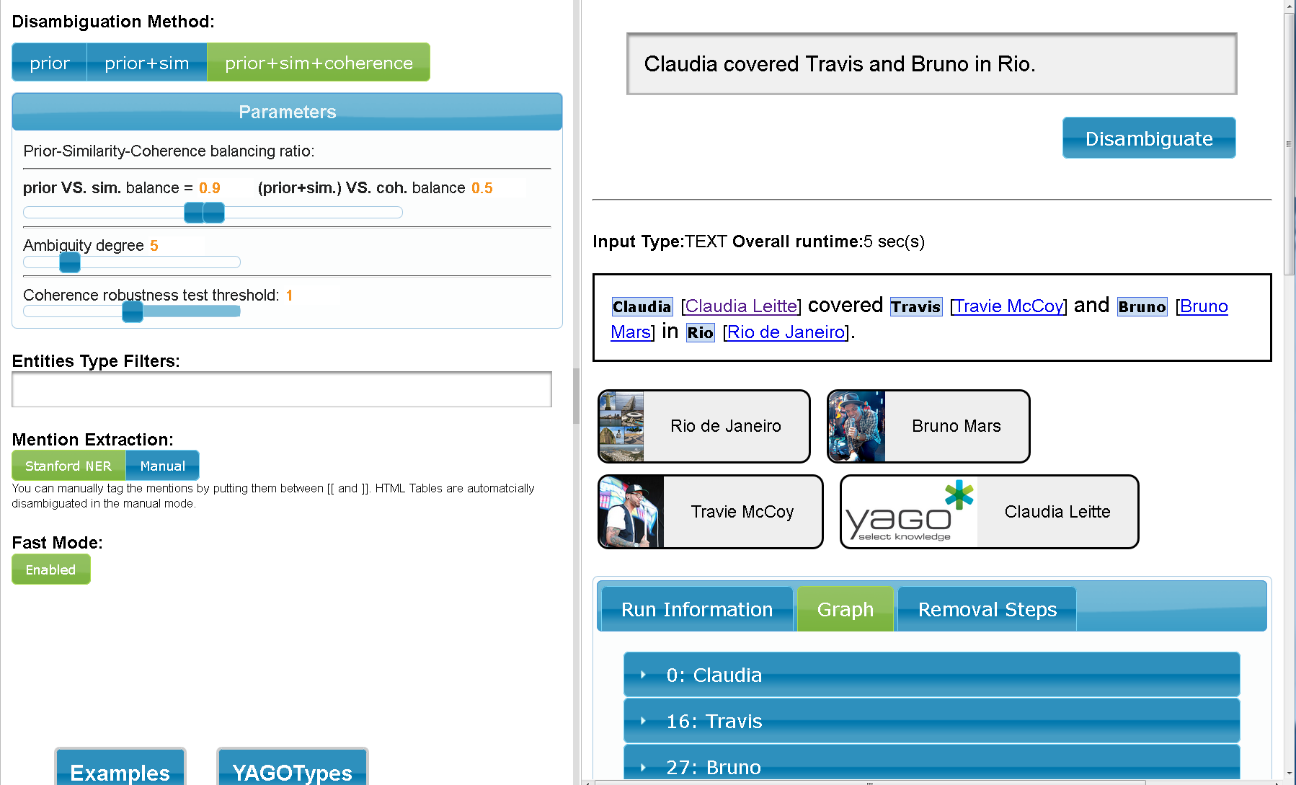
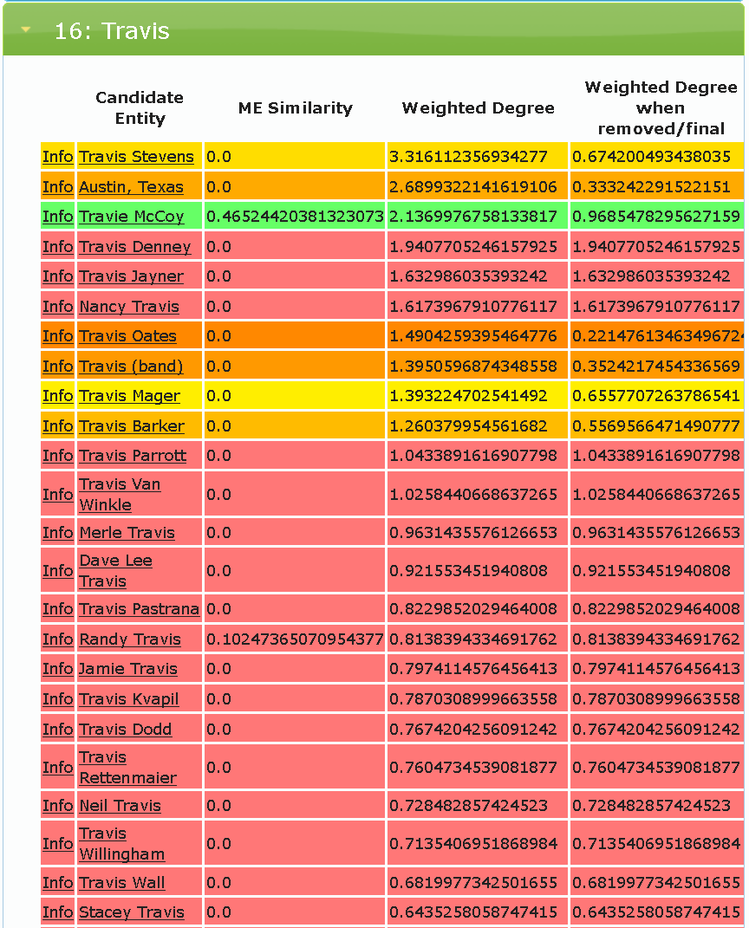
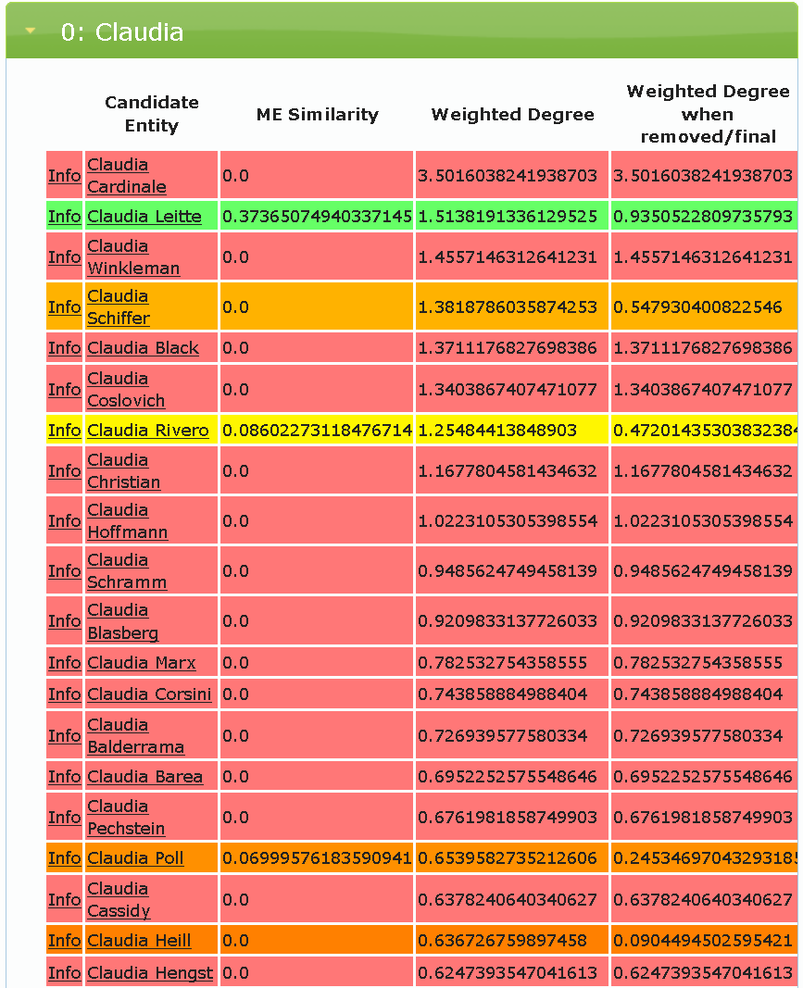
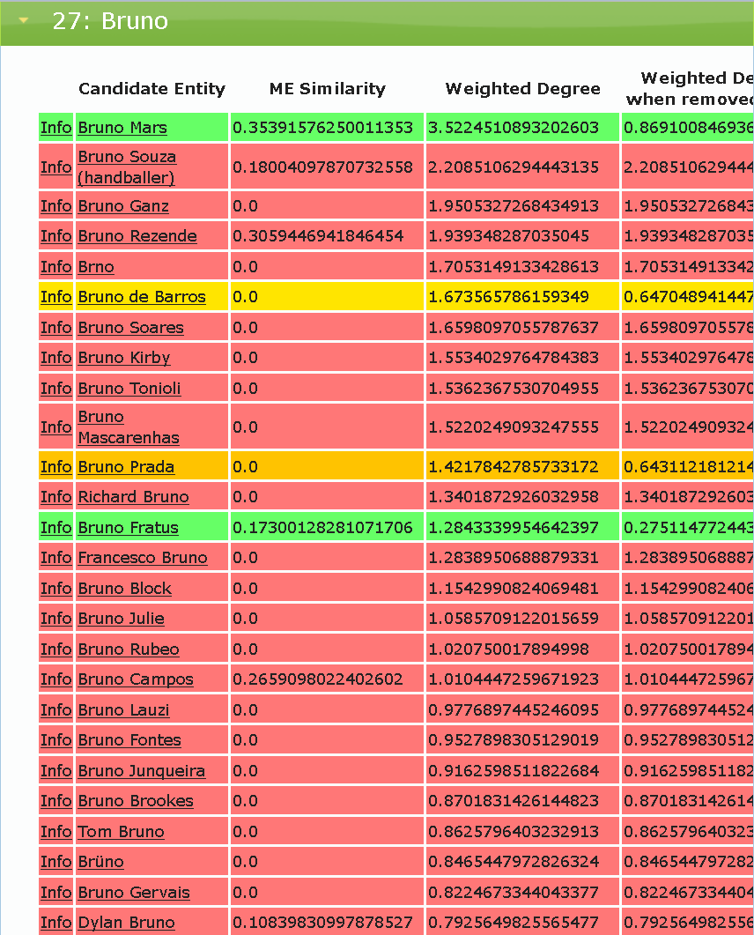
NERD at Work
https://gate.d5.mpi-inf.mpg.de/webaida/

Slide 26
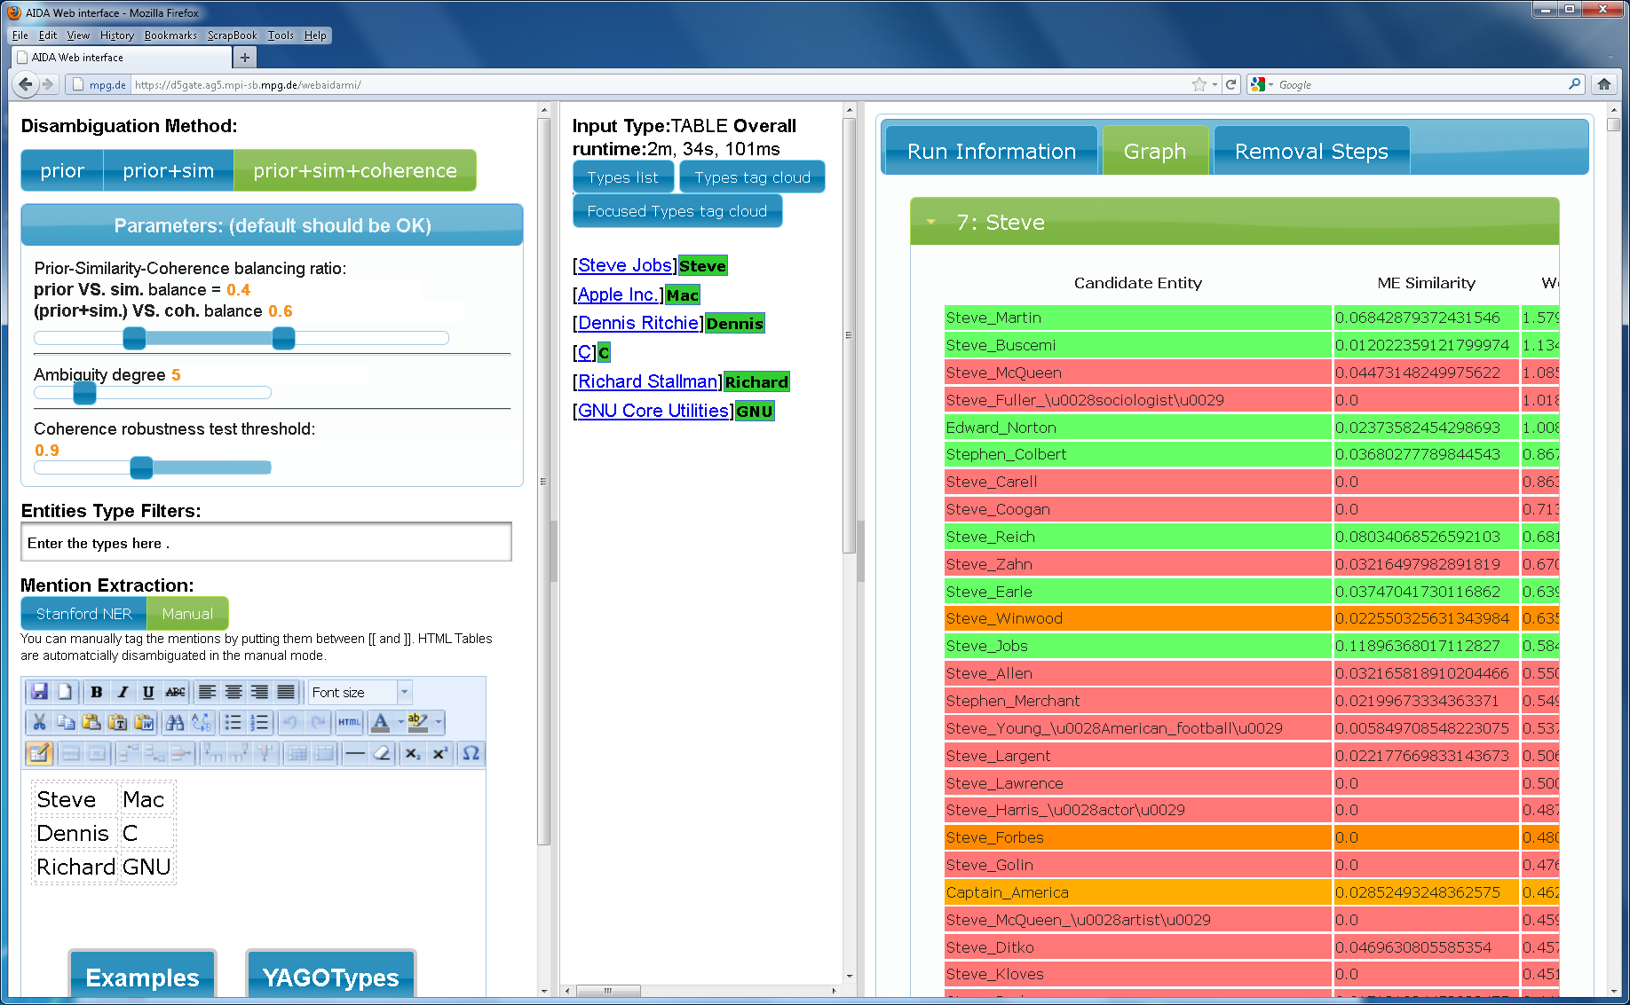
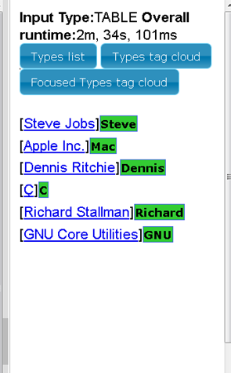
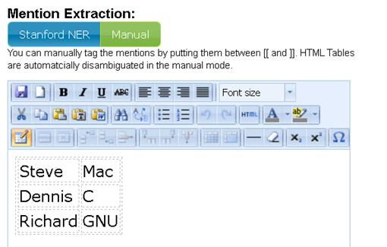
NERD on Tables

Slide 27
Entity Matching in Structured Data
Variety &
Veracity !
Hurricane Katrina New Orleans 2005
Hurricane Sandy New York 2012
……….
Hurricane Dylan
Like a Hurricane Young
Hurricane Everette.
Hurricane 1975
Forever Young 1972
Like a Hurricane 1975
……….
?
Dylan Bob 1941
Thomas Dylan Swansea 1914
Young Brigham 1801
Young Neil Toronto 1945
Denny Sandy London 1947
entity linkage:
  key to data integration
  long-standing problem, very difficult, unsolved
H.L. Dunn: Record Linkage. American Journal of Public Health 36 (12), 1946
H.B. Newcombe et al.: Automatic Linkage of Vital Records. Science 130 (3381), 1959

Slide 28
Entity Matching in Structured Data
e₁
f₁
e₂
f₂
f₃
e₃
f₄
sameAs linking: similarity of contexts

Slide 29
Entity Matching in Structured Data
e₁
f₁
g₁
e₂
f₂
f₃
g₂
g₃
e₃
f₄
sameAs linking: similarity of contexts
& coherence of neighborhoods
& constraints (transitivity etc.)
→ joint inference over (probabilistic) graph !

Slide 30
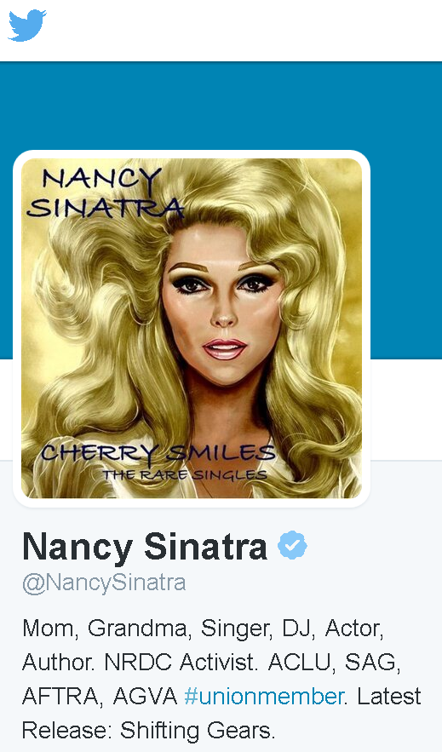
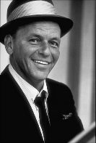

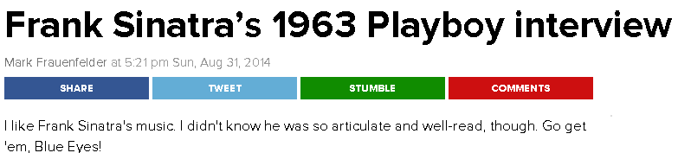
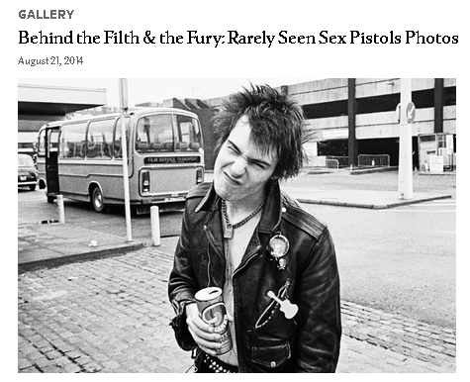

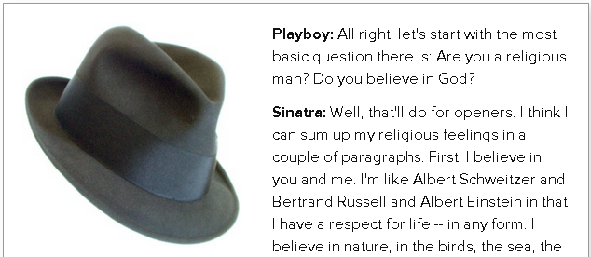
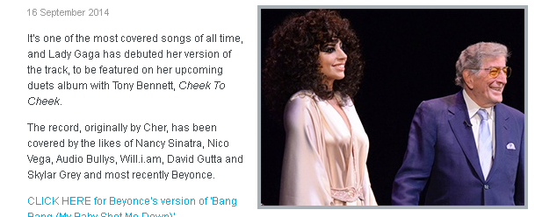
Linking Big Data & Big Text
Musician Song Year Listeners Charts . . .
Sinatra My Way 1969 435 420
Sex Pistols My Way 1978 87 729
Pavarotti My Way 1993 4 239
C. Leitte Famo$a 2011 272 468
B. Mars Billionaire 2010 218 116
. . . . . . . . . .
30

Slide 31
Research Challenges & Opportunities
Efficient interactive & high-throughput batch NERD
a day‘s news, a month‘s publications, a decade‘s archive
Entity name disambiguation in difficult situations
Short and noisy texts about long-tail entities in social media
Handling long-tail and emerging entities
to complement and continuously update KB
key for KB life-cycle management
Web-scale entity linkage with high quality
across text sources, linked data, KB‘s, Web tables, …

Slide 32
Outline

Introduction

Lovely NERD
The New Chocolate
The Dark Side
Conclusion

Slide 33

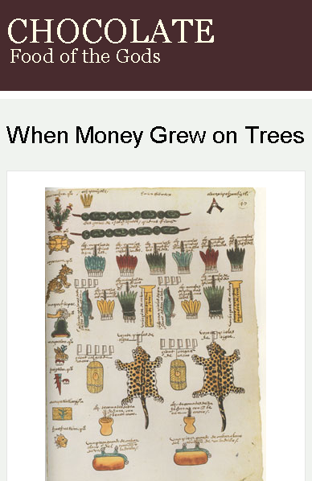
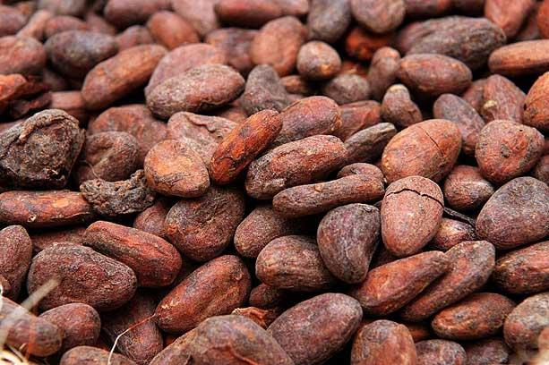

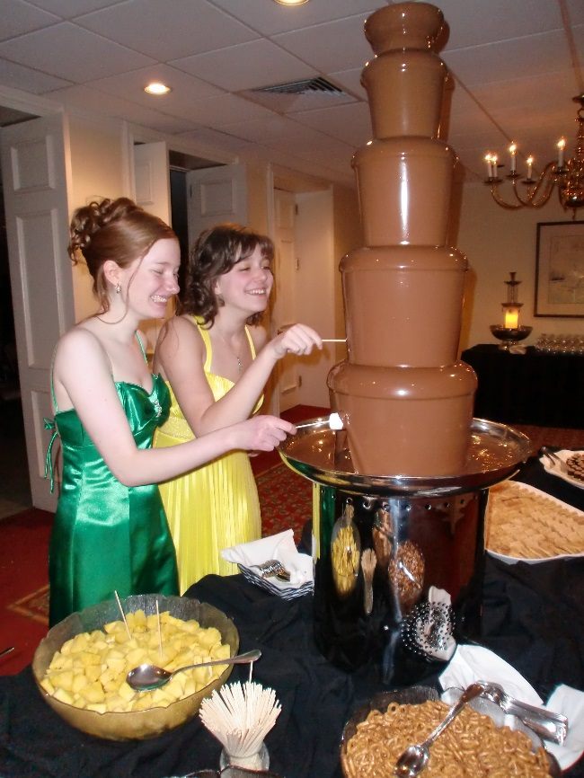
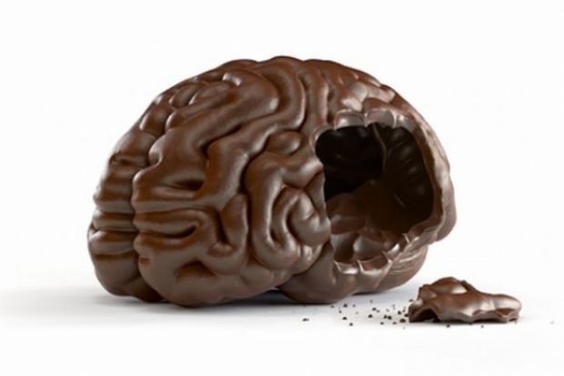
Big Text: the New Chocolate

Slide 34

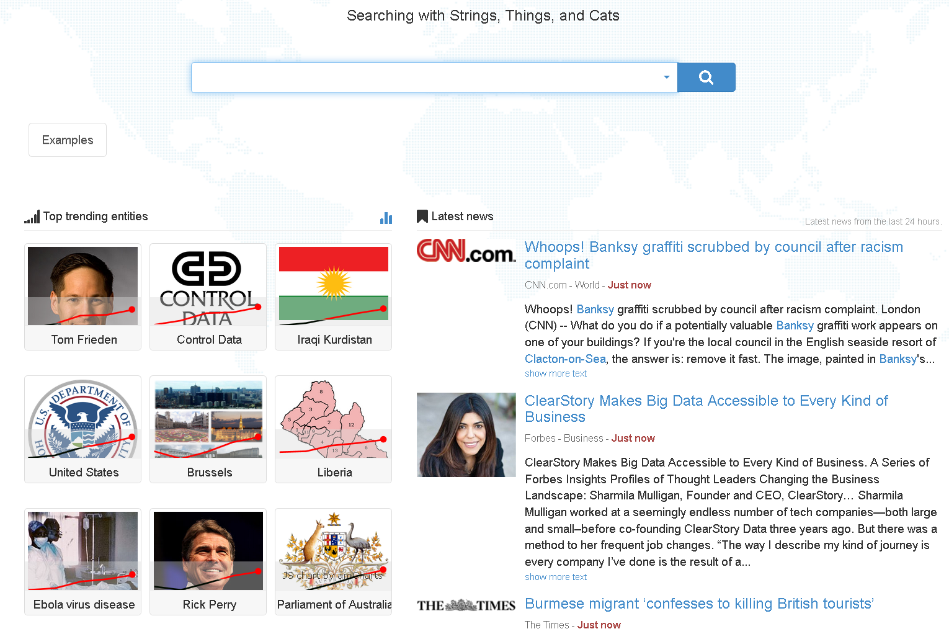

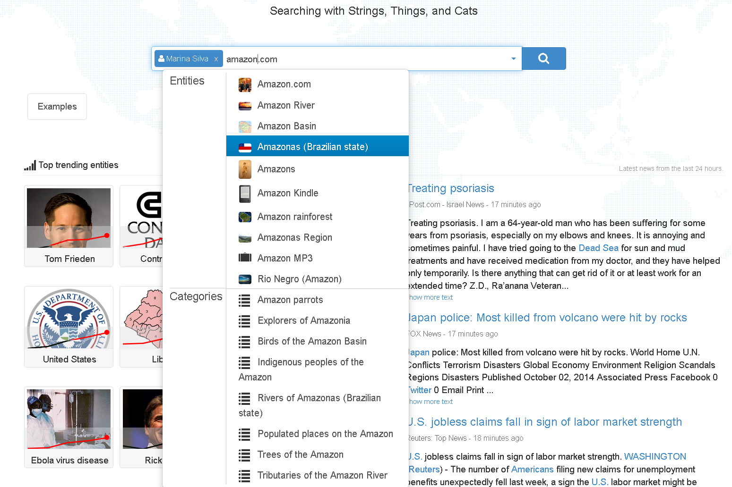
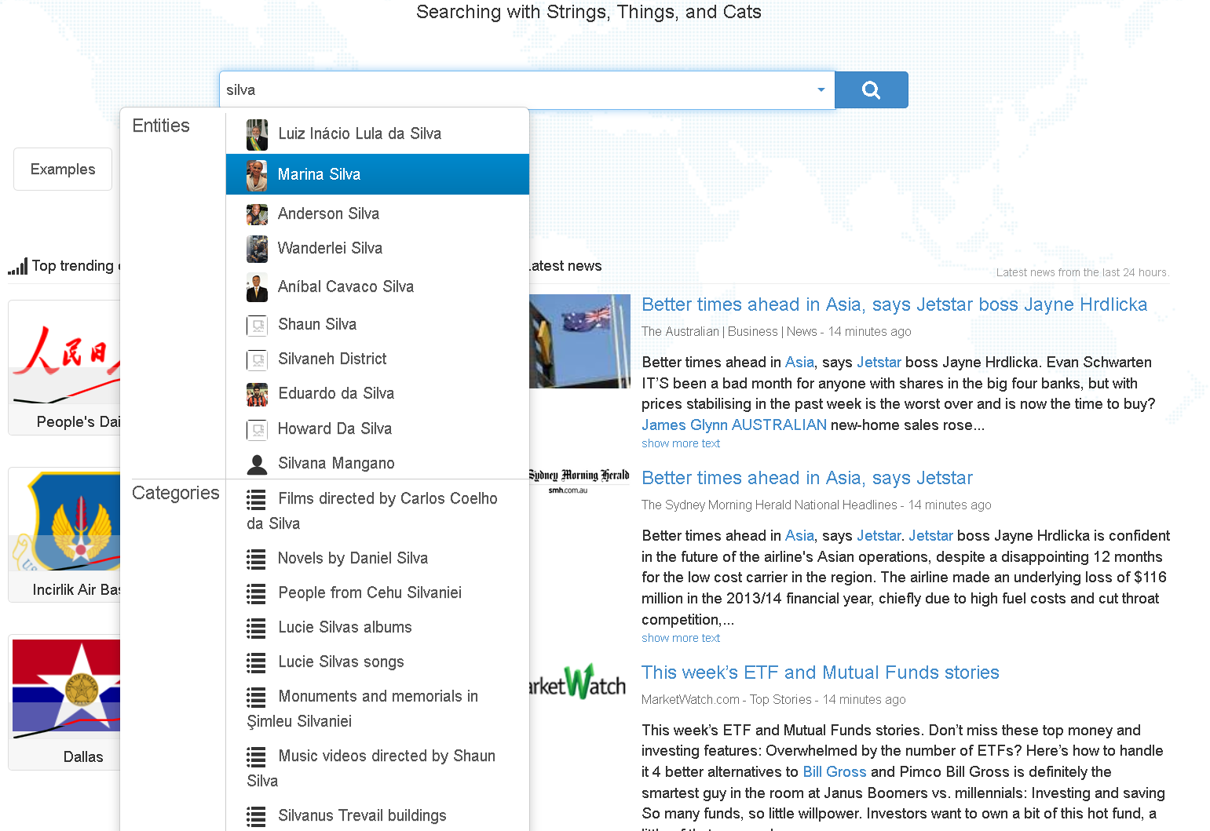
Semantic Search over News
https://stics.mpi-inf.mpg.de

Slide 35
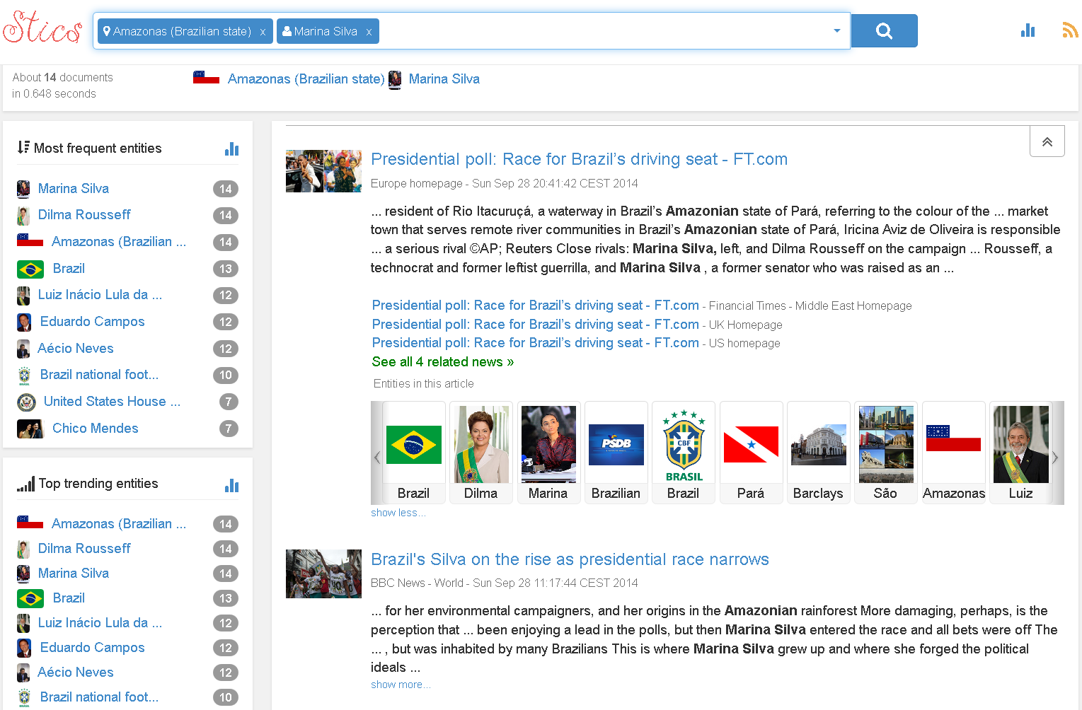
Semantic Search over News
https://stics.mpi-inf.mpg.de

Slide 36
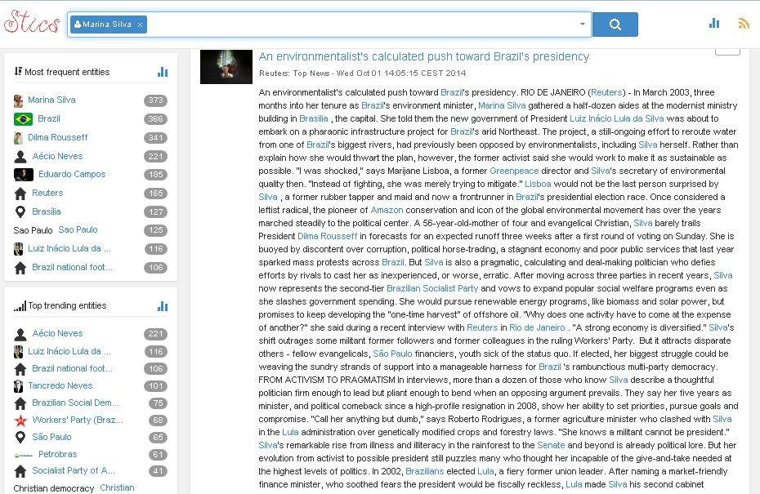
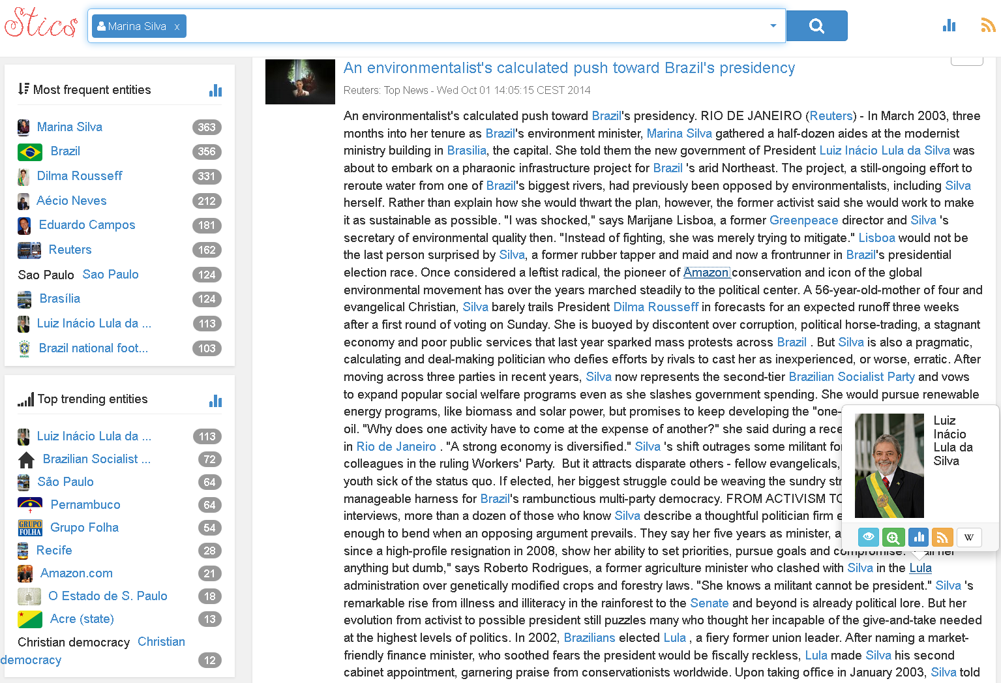

Semantic Search over News
https://stics.mpi-inf.mpg.de

Slide 37

Semantic Search over News
https://stics.mpi-inf.mpg.de

Slide 38


Semantic Search over News
https://stics.mpi-inf.mpg.de

Slide 39

Semantic Search over News
https://stics.mpi-inf.mpg.de

Slide 40

Entity Analytics over News
https://stics.mpi-inf.mpg.de

Slide 41


Entity Analytics over News
https://stics.mpi-inf.mpg.de

Slide 42




Machine Reading of Scholarly Papers
https://gate.d5.mpi-inf.mpg.de/knowlife/

Slide 43



Machine Reading of Health Forums
https://gate.d5.mpi-inf.mpg.de/knowlife/
[P. Ernst et al.: ICDE‘14]

Slide 44







Big Data & Text Analytics:
Side Effects of Drug Combinations
Deeper insight from both
expert data & social media:
actual side effects of drugs
… and drug combinations
risk factors and complications
of (wide-spread) diseases
alternative therapies
aggregation & comparison by
age, gender, life style, etc.
Structured
Expert Data
Social
Media
http://dailymed.nlm.nih.gov
http://www.patient.co.uk

Slide 45



Credibility of Statements in Health Communities
[S. Mukherjee et al.: KDD‘14]
I took the whole med
cocktail at once.
Xanax gave me
wild hallucinations
and a demonic feel.
Xanax and Prozac
are known to
cause drowsiness.
Xanax made me
dizzy and sleepless.
Language Objectivity
User Trustworthiness
p1
u1
p2
u2
p3
u3
s1
s2
Statement Credibility
joint reasoning with probabilistic graphical model

Slide 46
Machine Reading: from Names and Phrases to Entities, Classes, and Relations
The Maestro from Rome wrote scores for westerns.
Ma played his version of the Ecstasy.
Maestro
Card
Rome
(Italy)
Jack
Ma
MDMA
Leonard
Bernstein
AS
Roma
Yo-Yo
Ma
l‘Estasi
dell‘Oro
Lazio
Roma
Ennio
Morricone
goal in
football
plays
sport
western
movie
born in
cover of
plays for
film
music
plays
music
story about
Western
Digital

Slide 47
Paraphrases of Relations
composed: musician × song
covered: musician × song
Dylan wrote a sad song Knockin‘ on Heaven‘s Door, a cover song by the Dead
Morricone ‘s masterpiece is the Ecstasy of Gold, covered by Yo-Yo Ma
Amy‘s souly interpretation of Cupid, a classic piece of Sam Cooke
Nina Simone‘s singing of Don‘t Explain revived Holiday‘s old song
Cat Power‘s voice is haunting in her version of Don‘t Explain
Cale performed Hallelujah written by L. Cohen
  SOL patterns over words, wildcards, POS tags, semantic types:
<musician> wrote ∗ ADJ piece <song>
Sequence Mining
with Type Lifting
(N. Nakashole et al.:
EMNLP’12, ACL’13,
VLDB‘12)
  Relational phrases are typed:
<singer> covered <song>
<book> covered <event>
  Relational synsets (and subsumptions):
covered: cover song, interpretation of, singing of, voice in ∗ version, …
composed: wrote, classic piece of, ‘s old song, written by, composed, …
350 000 SOL patterns from Wikipedia: http://www.mpi-inf.mpg.de/yago-naga/patty/

Slide 48
Disambiguation for Entities, Classes & Relations
(M. Yahya et al.: EMNLP’12, CIKM‘13)
e: MaestroCard
Maestro
e: Ennio Morricone
c: conductor
c: musician
from
r: actedIn
r: bornIn
ILP
optimizers
like Gurobi
solve this
in seconds
e: Rome (Italy)
Rome
weighted edges (coherence, similarity, etc.)
e: Lazio Roma
r: composed
wrote scores
r: giveExam
c:soundtrack
scores for
r: soundtrackFor
r: shootsGoalFor
westerns
c: western movie
e: Western Digital
Combinatorial Optimization by ILP (with type constraints etc.)

Slide 49
Outline

Introduction

Lovely NERD

The New Chocolate
The Dark Side
Conclusion

Slide 50



The Dark Side of Big Data
Nobody interested
in your research?
We read your papers!

Slide 51

















Entity Linking: Privacy at Stake
Zoe
search
publish & recommend
discuss & seek help
female 25-30 Somalia
female 29y Jamame
Synthroid tremble
……….
Addison disorder
……….
Levothroid shaking
Addison’s disease
………
Nive concert
Greenland singers
Somalia elections
Steve Biko
Cry
Freedom
Nive Nielsen
social
network
online
forum
search
engine
Internet

Slide 52
Privacy Adversaries
Linkability
Threats:
Weak cues: profiles, friends, etc.
Semantic cues: health, taste, queries
Statistical cues: correlations
search
publish & recommend
discuss & seek help
female 25-30 Somalia
female 29y Jamame
Synthroid tremble
……….
Addison disorder
……….
Levothroid shaking
Addison’s disease
………
Nive concert
Greenland singers
Somalia elections
Steve Biko
Cry
Freedom
Nive Nielsen
social
network
online
forum
search
engine
Internet
Notes:
There is a variety of privacy threats in such a common setting. Here I focus on the class of linkability threats: discovering that two identities on different platforms are really the same person. There are weak cues from the similarity of profiles, but an adversary would have to make wild guesses.
There are much stronger linkability threats from the posted contents, once we consider semantic cues, for example, that Synthroid and Levothroid are drugs for the same medical condition. This could lead to linking Zoe's search history with her anonymous identity in the health forum.
There are also statistical cues: the likelihood that two different people from Namibia both like this Greenlandic singer is very low. This way, an adversary could link Zoe's queries with her Facebook account, and by transitivity also her real-life identity with her sensitive discussions in the anonymized health forum.

Slide 53
Goal: Automated
Privacy Advisor
Privacy
Adviser (PA):
Software tool that
analyses risk
alerts user
advises user
search
publish & recommend
discuss & seek help
  explains consequences
  recommends
  policy changes
female 25-30 Somalia
female 29y Jamame
Synthroid tremble
……….
Addison disorder
……….
Levothroid shaking
Addison’s disease
………
Nive concert
Greenland singers
Somalia elections
Your queries may lead to linking your identies
in Facebook and patient.co.uk !
………….
Would you like to use an anonymization tool
for your search requests?
………..
Cry
Freedom
Nive Nielsen
social
network
social
network
online
forum
search
engine
ERC Project imPACT
(Backes/Druschel/Majumdar/Weikum)
Internet

Slide 54
Probabilistic Prediction of Privacy Risks
in User Search Histories
[J. Biega et al.:
PSBD‘14]
User: 352348
User: 843043
recent aids research
hiv aids donations
hiv therapies
physiology exam
med schools canada
User: 172477
signs of hiv
aids and brain
hiv symptoms
meningitis in aids
hiv blood level 100
visible hiv symptoms
hiv and arm rash
hiv cryptococcus
hiv and nodules
hiv and spots on arm
student aids
vocabulary teaching aids
toefl exam
listening comprehension
Predict “educated guess“ attacks:
P[sensitive topic | suggestive terms &
common terms]
Ex.: P[alcoholism | drunk, blackout, therapy,
party, drive, …]
blackout
alcoholism
party
using probabilistic
graphical model
(Markov Logic)
drunk
alcohol
abuse
drive
therapy
. . . . .

Slide 55
Research Challenges & Opportunities
Which data is (or can be linked to become) privacy-critical?
  highly user-specific, but needs a global perspective
How are privacy risks building up over time?
where is my data, who has seen it, who can copy and accumulate it
Who are the adversaries? How powerful? At which cost?
role of background knowledge & statistical learning
Explain risks, advise on consequences,
recommend counter-measures and mitigation steps
Long-term privacy management:
policies, risks, privacy-utility trade-offs

Slide 56
Outline

Introduction

Lovely NERD

The New Chocolate

The Dark Side
Conclusion

Slide 57
Big Text & Big Data
Big Text & NERD:
valuable content about entities
lifted towards knowledge & analytic insight
Machine Reading:
discover and interpret names & phrases as
entities, classes, relations,
spatio-temporal modifiers, sentiments, beliefs, ….
Big Data:
interlink natural-language text, social media,
structured data & knowledge bases, images, videos
and help users coping with privacy risks

Slide 58


Take-Home Message:
From Language to Knowledge
more knowledge, analytics, insight
knowledge
acquisition
Web
Contents
Knowledge
Knowledge
Obrigado
„Who Covered Whom?“ and More!
(Entities, Classes, Relations)

